Slide 1
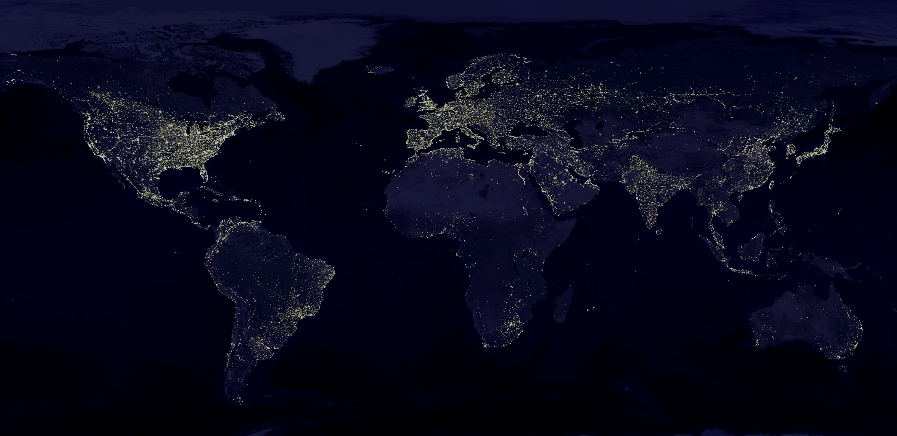






Physics 305– White Noise Analysis
Black Marble
nighttime lights.
Final Project by Rene L. Principe Jr.. National Institute of Physics, University of the Philippines Diliman
rprincipe@nip.upd.edu.ph | rlprincipe@up.edu.ph rlprincipe.wixisite.com/reneprincipejr

Slide 2
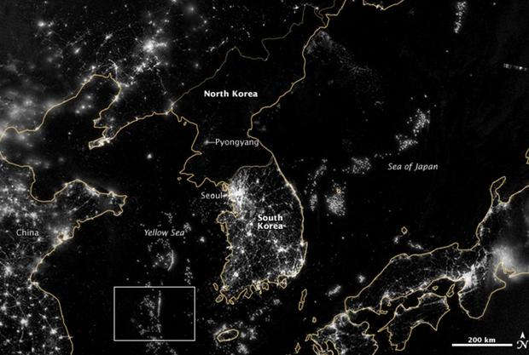
North/South Korea divide
NASA EARTH OBSERVATORY IMAGE BY JESSE ALLEN AND ROBERT SIMMON
https://www.cbsnews.com/pictures/north-korea-hermit-country-space-photos/3/
Notes:
North Korea has faced "chronic economic problems" under the repressive Kim dynasty. A widespread famine in the 1990s, exacerbated by the Kim policy of "self reliance" and the closed economy that prevented food imports, killed between half a million and up to 3 million people, according to different estimates.

Slide 3
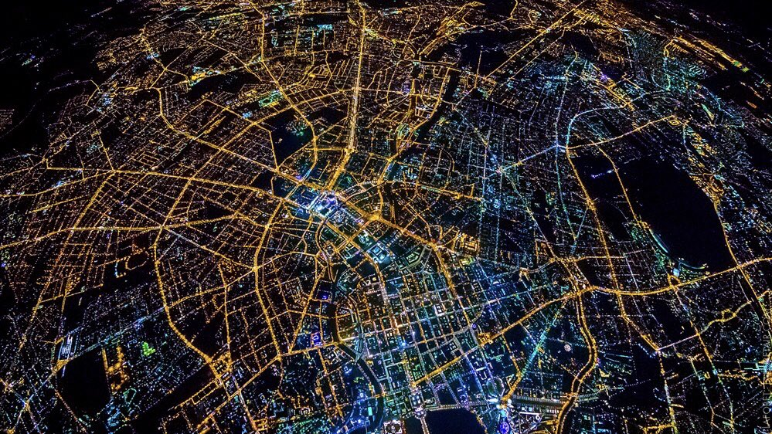
Berlin, Germany (2020)
https://twitter.com/NorbertElekes/status/1325892921590210560/photo/1
Notes:
The Berlin Wall was built by the German Democratic Republic during the Cold War to prevent its population from escaping Soviet-controlled East Berlin to West Berlin, which was controlled by the major Western Allies. It divided the city of Berlin into two ideologically contrasting zones that still manifests physically in terms of lightting.
Nov 10, 1989: The Berlin Wall fell, reuniting East and West Germany. 31 years later, you can still see the divide between the two sides. • East: yellow light bulbs • West: colorful light bulbs

Slide 4
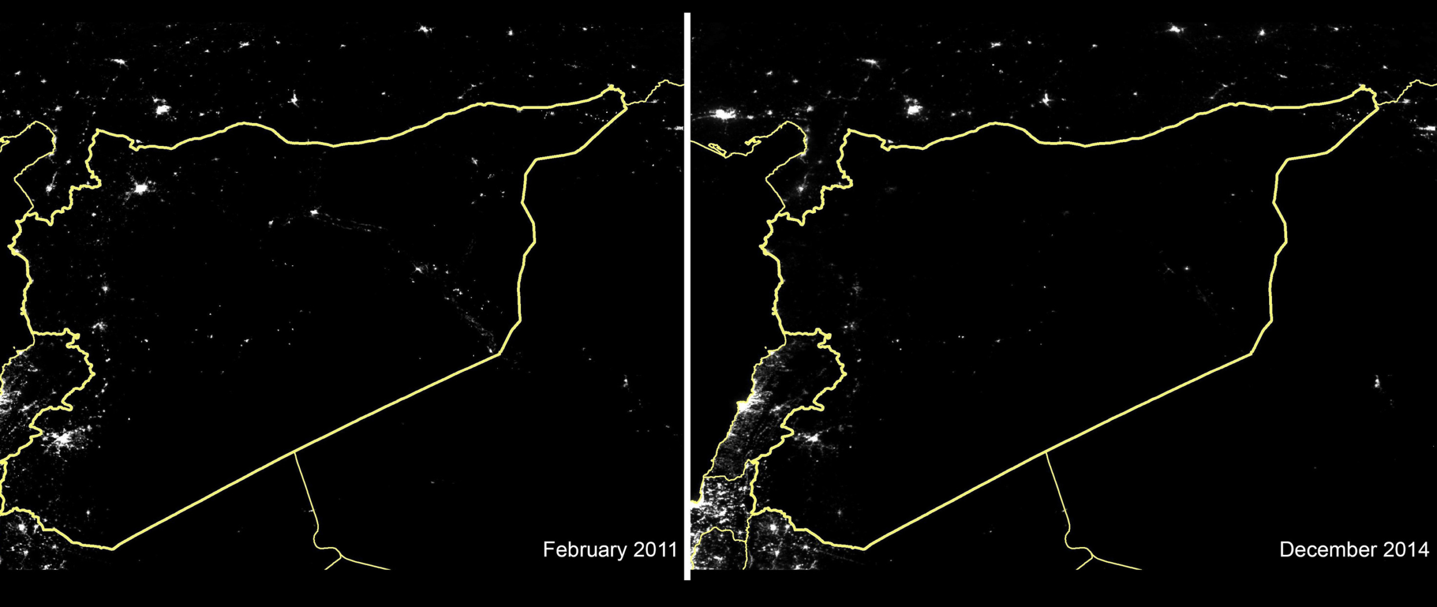
Crisis in Syria (83% NTL reduction)
Photo: Satellite images showing night time light levels across Syria in February 2011 and December 2014 © #WithSyria and Wuhan University
https://www.amnesty.org/en/latest/news/2015/03/syria-goes-dark-83-of-lights-out-after-four-years-of-crisis/
Notes:
Syria goes dark: 83% of lights out after four years of crisis

Slide 5
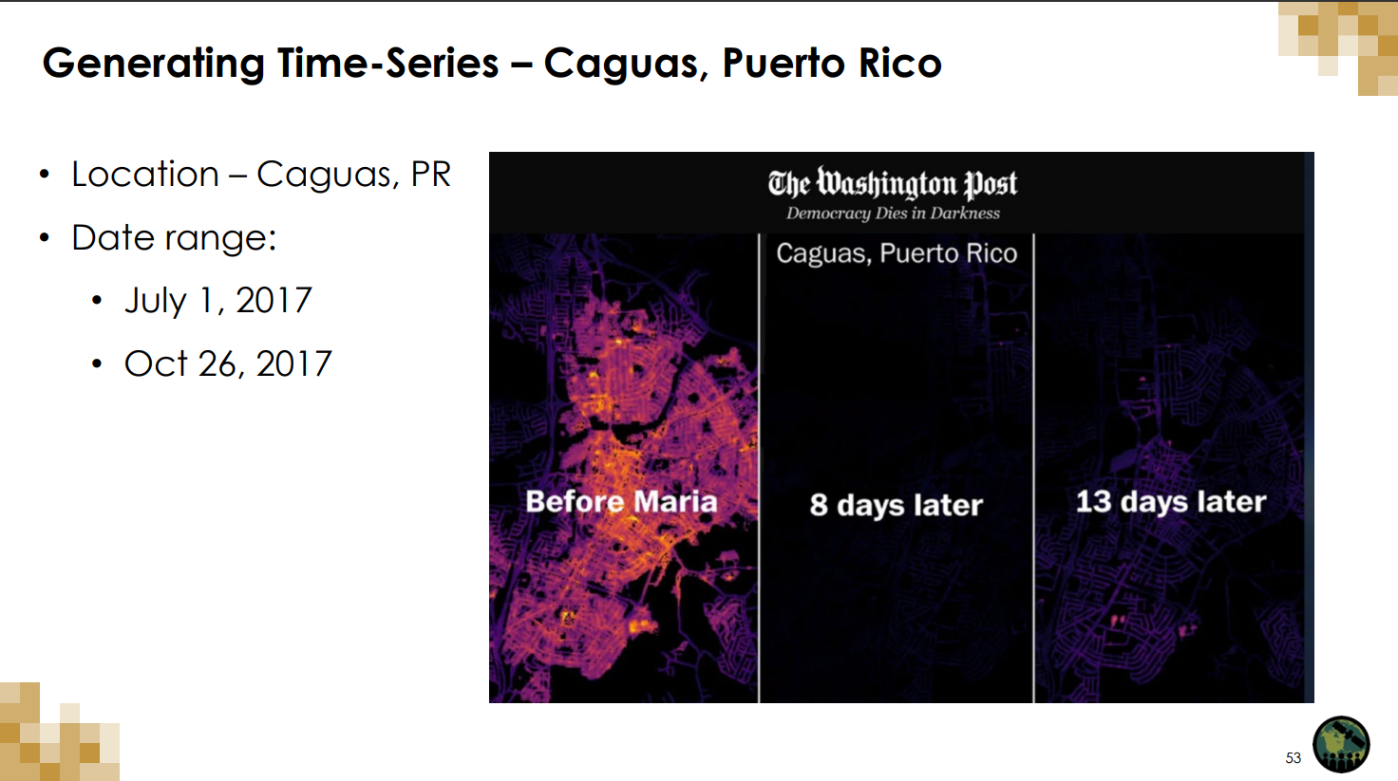
Puerto Rico after Maria

Slide 6
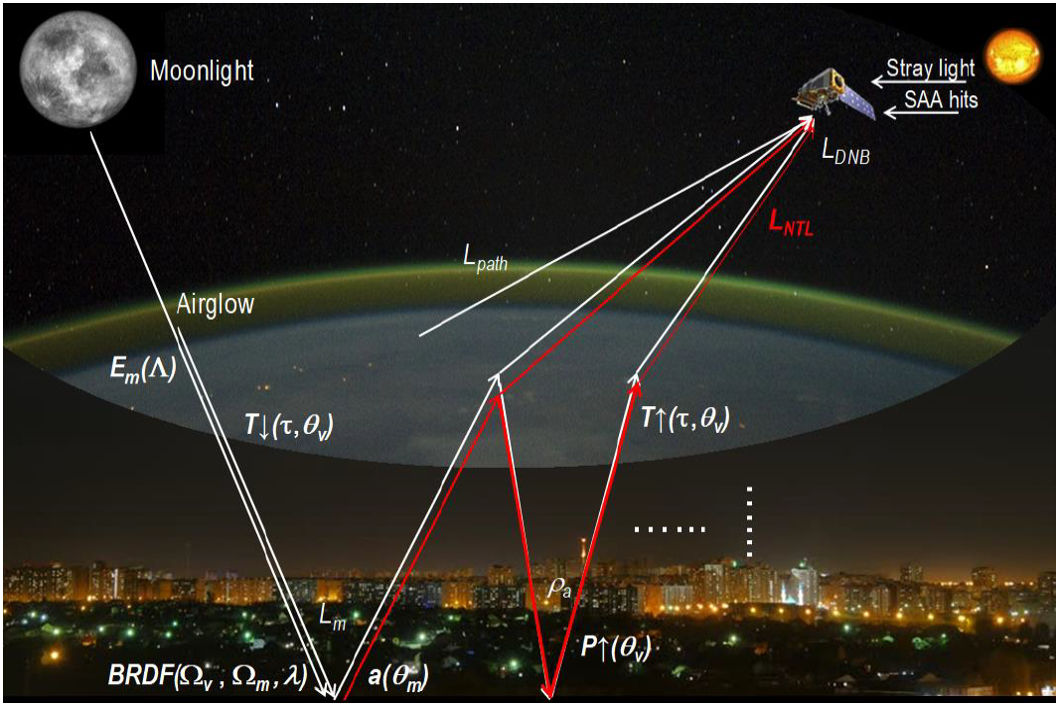
Principles of nighttime lights | Miguel O. Roman et al. NASA’s Black Marble nighttime lights product suite. Remote Sensing of Environment, 210:113–143, 7 2018.
Notes:
The NTL that the satellite detects is a combination of multiple light sources from artificial lighting observations (streets, buildings, boats, etc.) and natural sources (aurora, bioluminescence, etc.). Since its availability in the 1970’s, a multitude of studies have exploited NTL as a sufficient proxy for a wide array of social, economic, and environmental indicators.

Slide 7
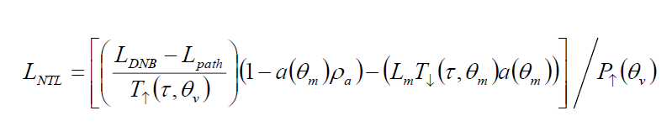
Atmospheric Correction
L_{NTL} : surface upward radiance from artificial light emissions
L_{DNB} : at-sensor nighttime radiances
L_{path} : nighttime path radiance
a(θ_{m}): VIIRS-derived actual surface albedo
ρ_{a} : atmospheric backscatter
T↑(τ,θ_{v}), T↓(τ,θ_{v}) : total transmittances along lunar-ground and ground sensor paths respectively
P↑(θ_{v}) : probability of upward transmission of NTL emissions through urban vegetation canopy

Slide 8
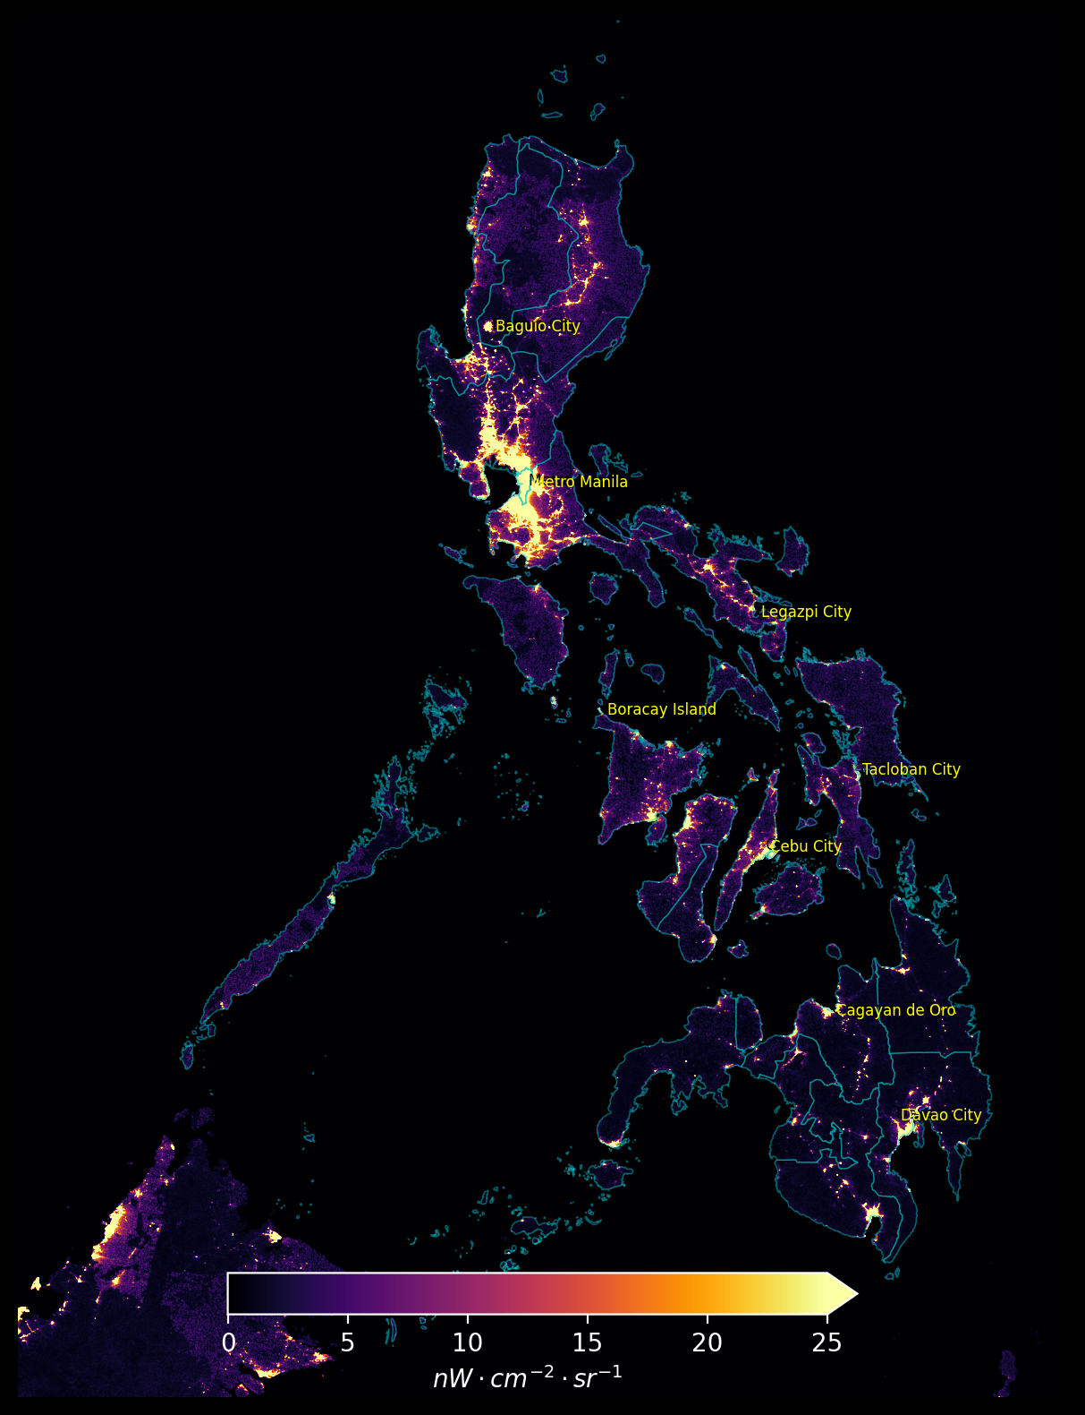

Slide 9
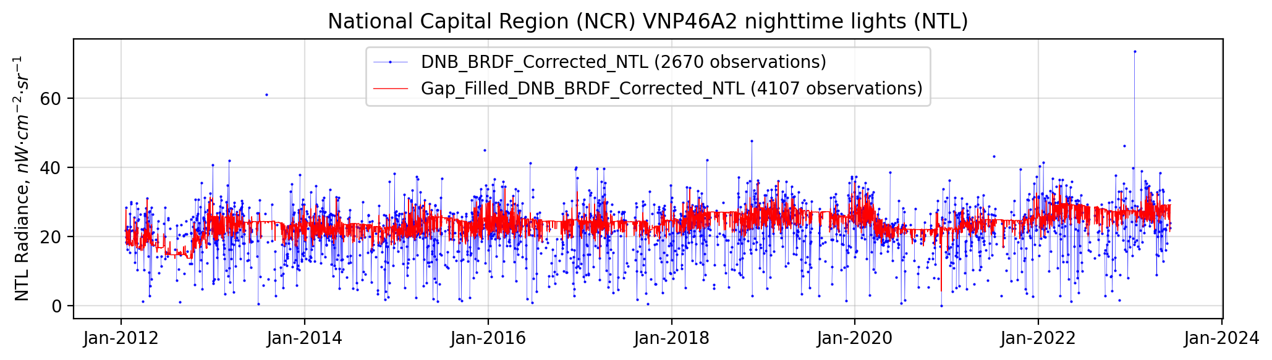
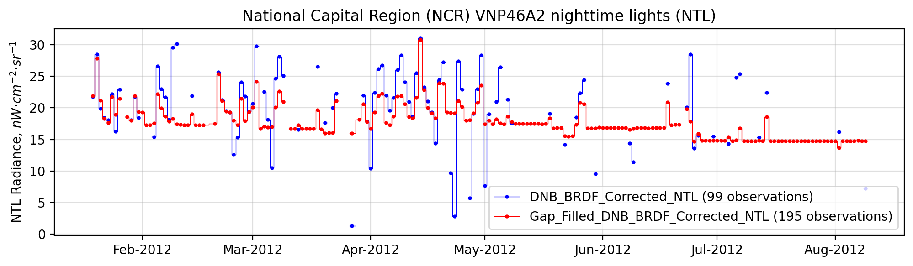
Regional NTL Data

Slide 10
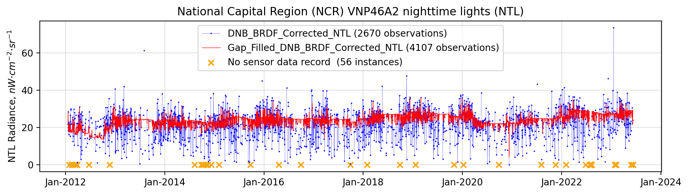
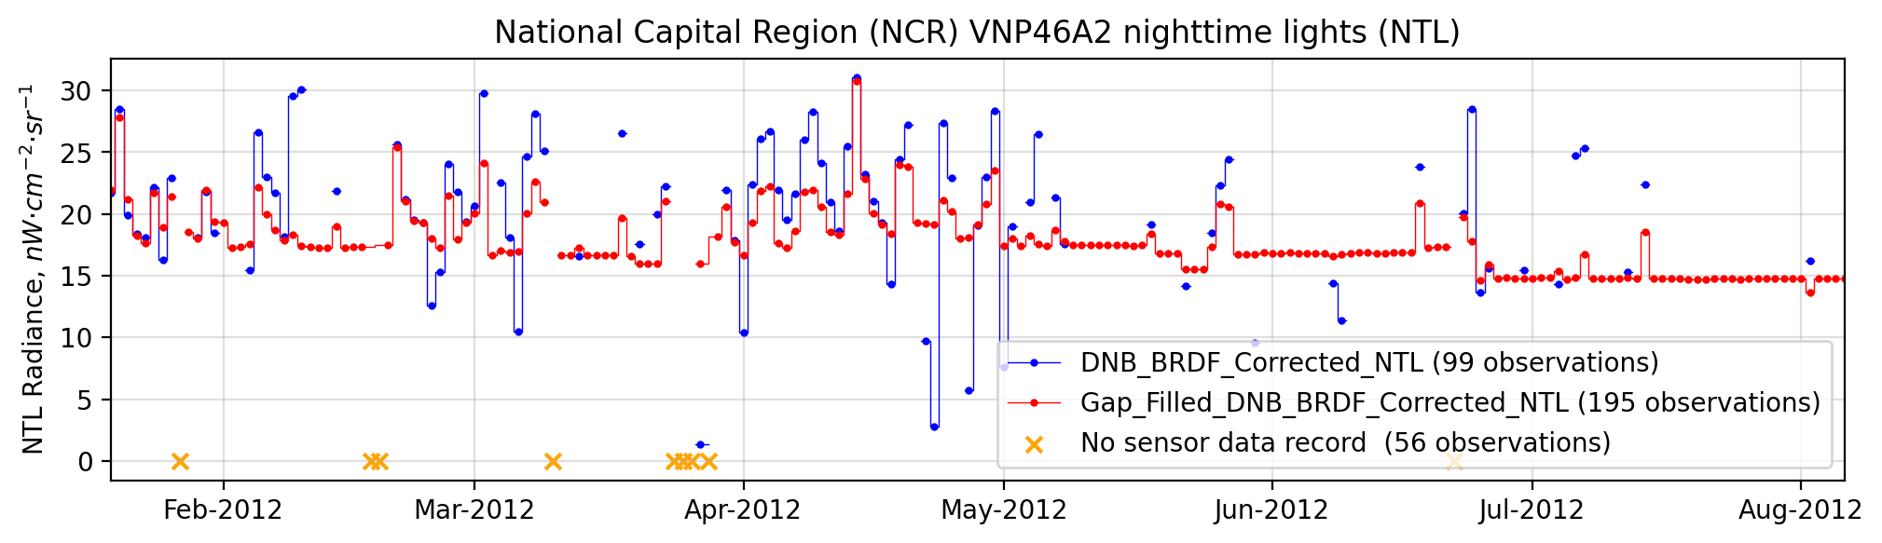
Regional NTL Data

Slide 11
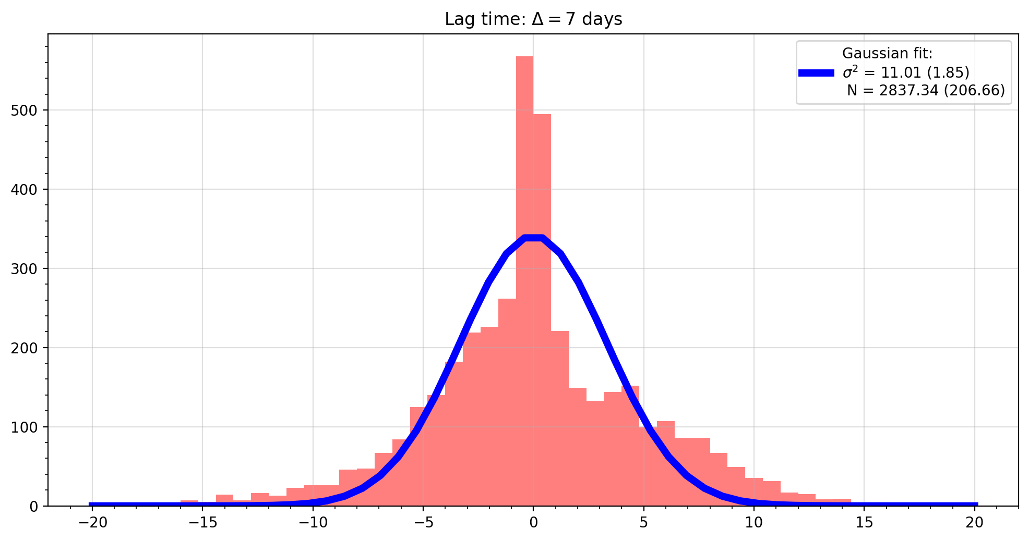
[PDF] Gaussian Fitting

Slide 12
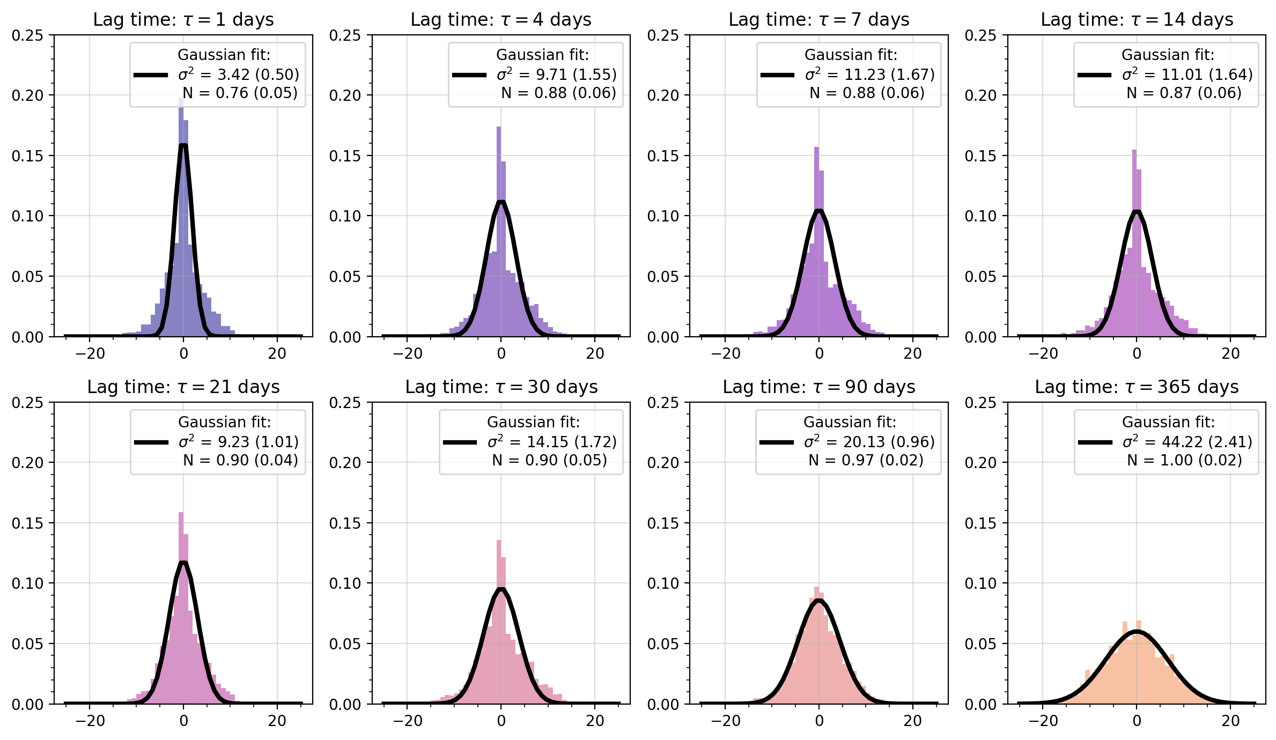
[PDF] Relevant Lag Times

Slide 13
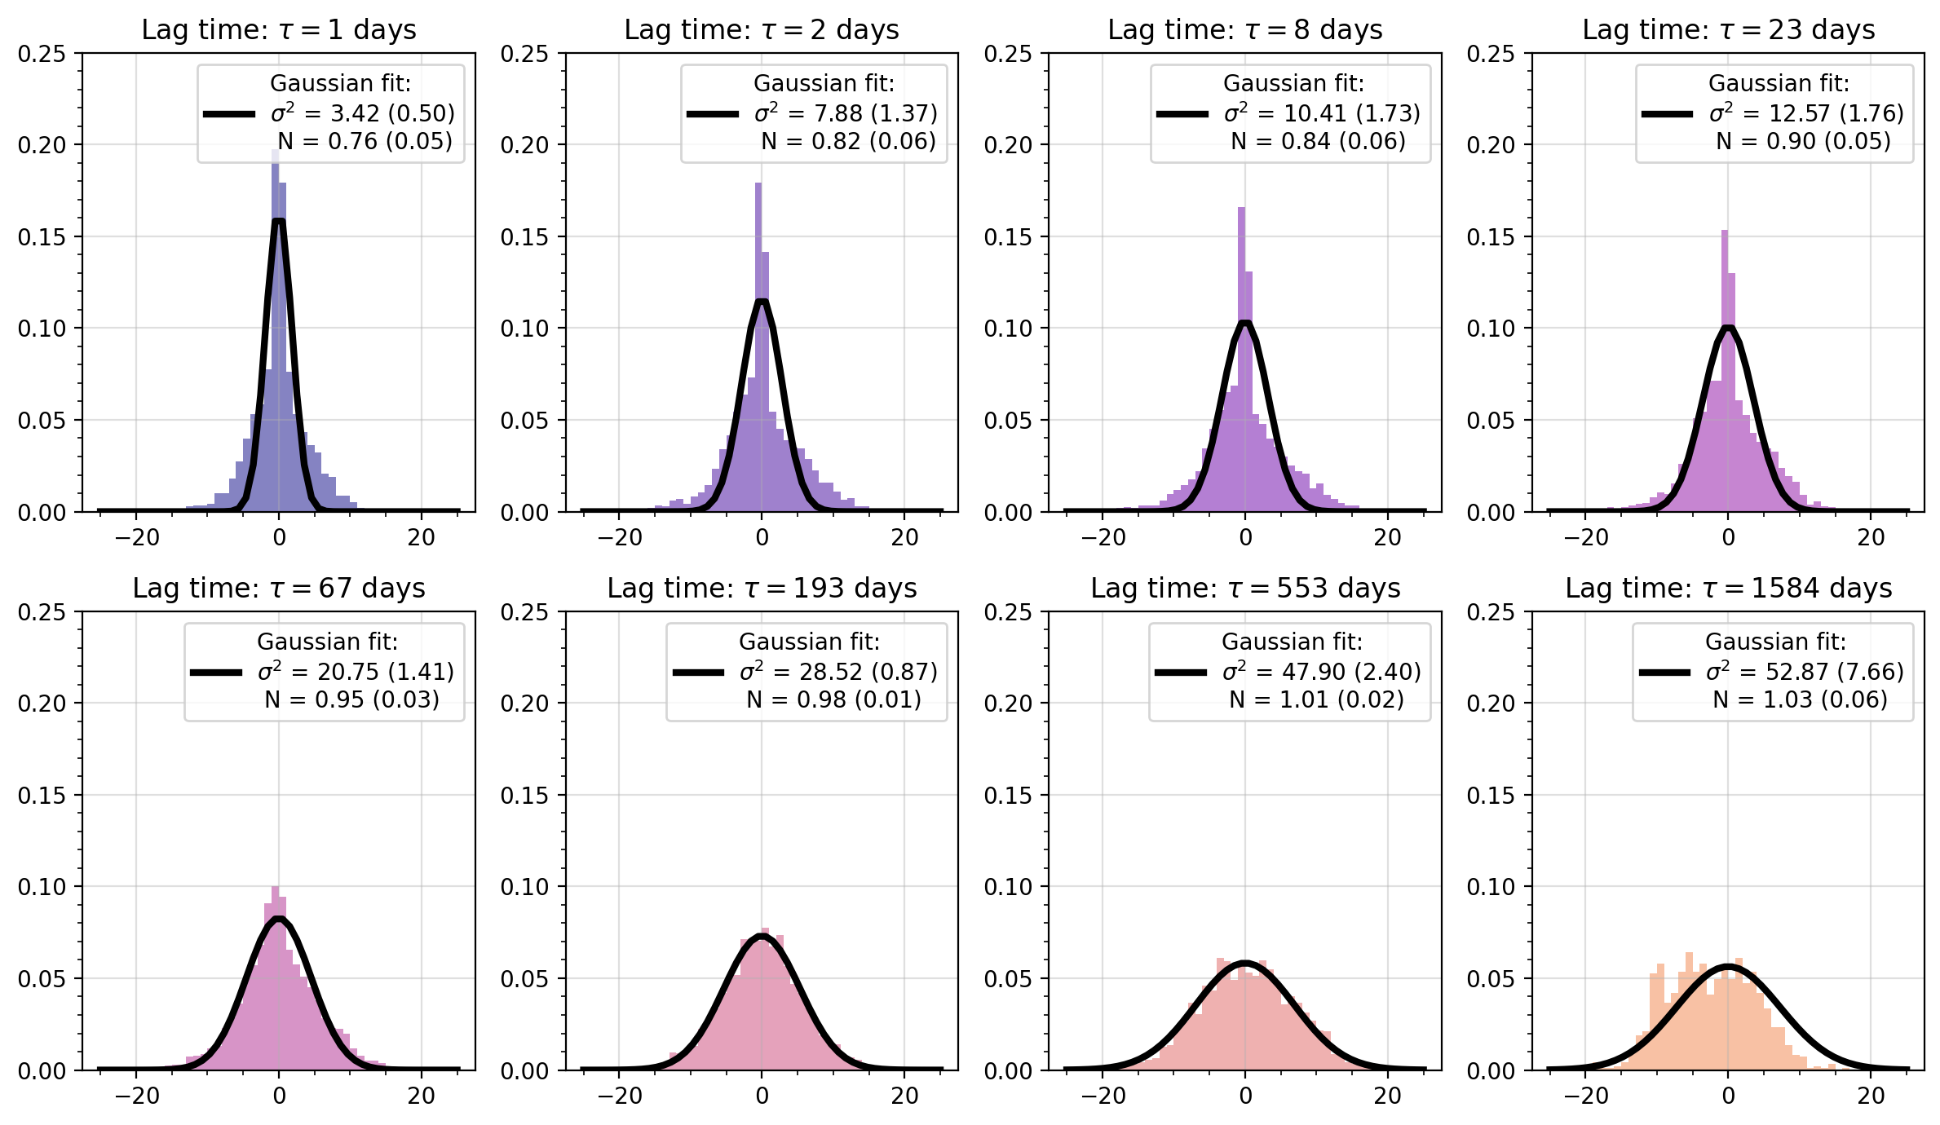
[PDF] Log-spaced Lag Times

Slide 14
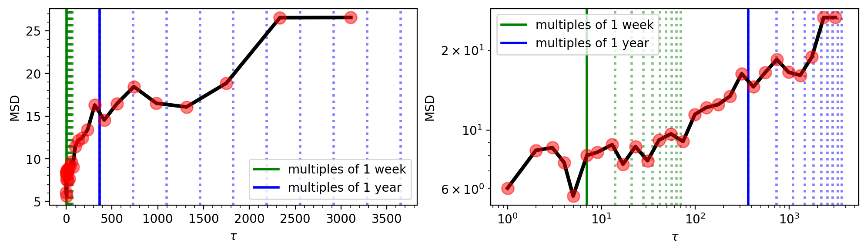
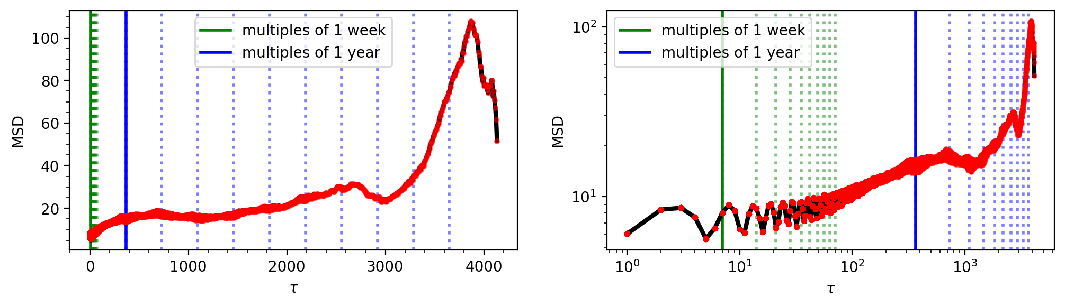
[MSD] Discrete and Continuous

Slide 15
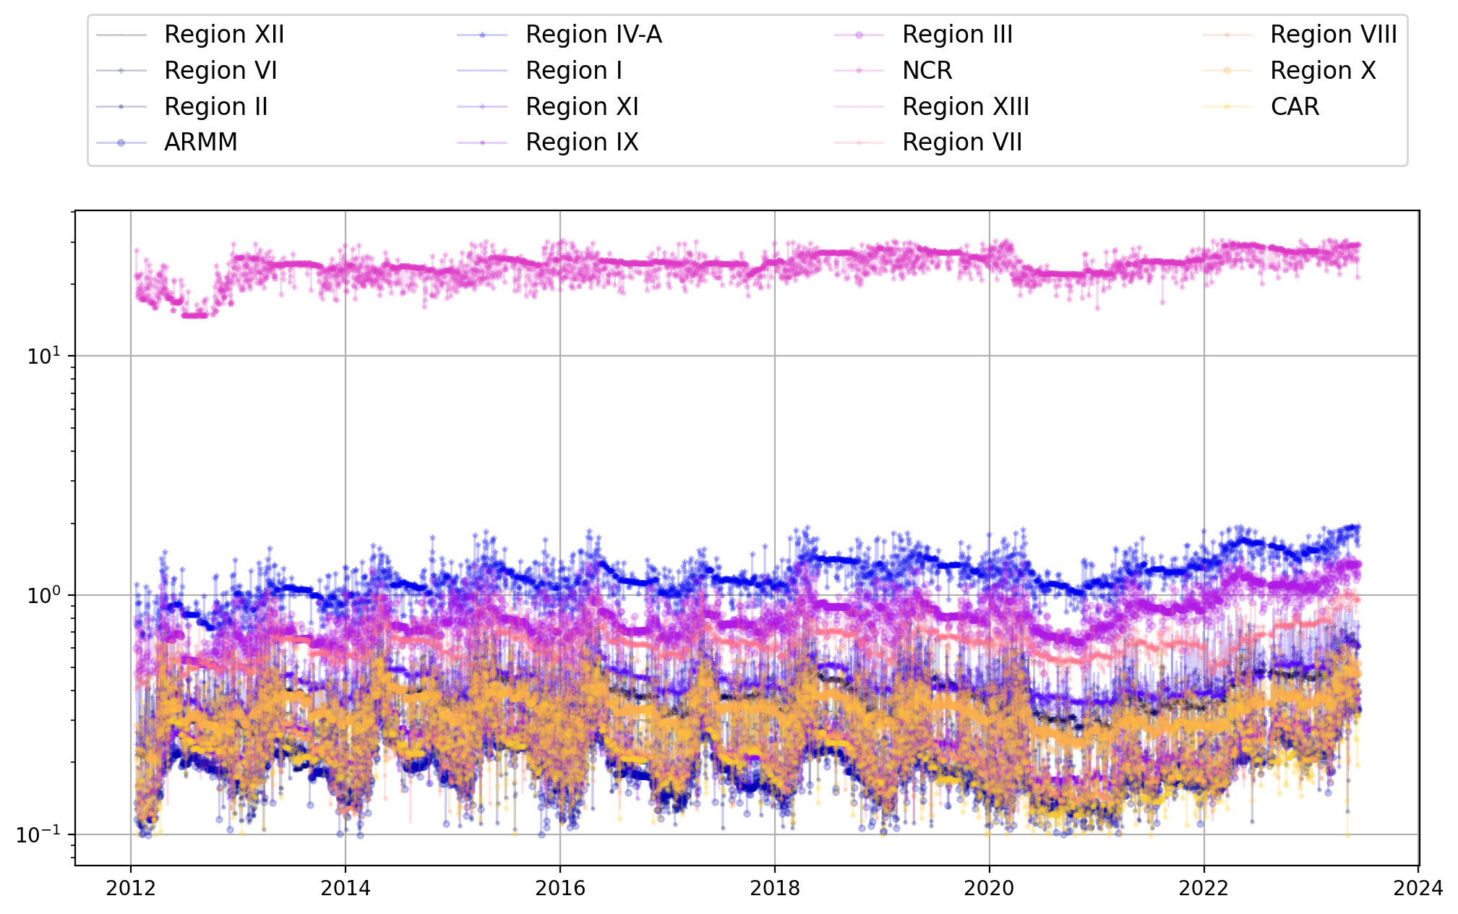
[NTL] Regional Monthly NTL

Slide 16
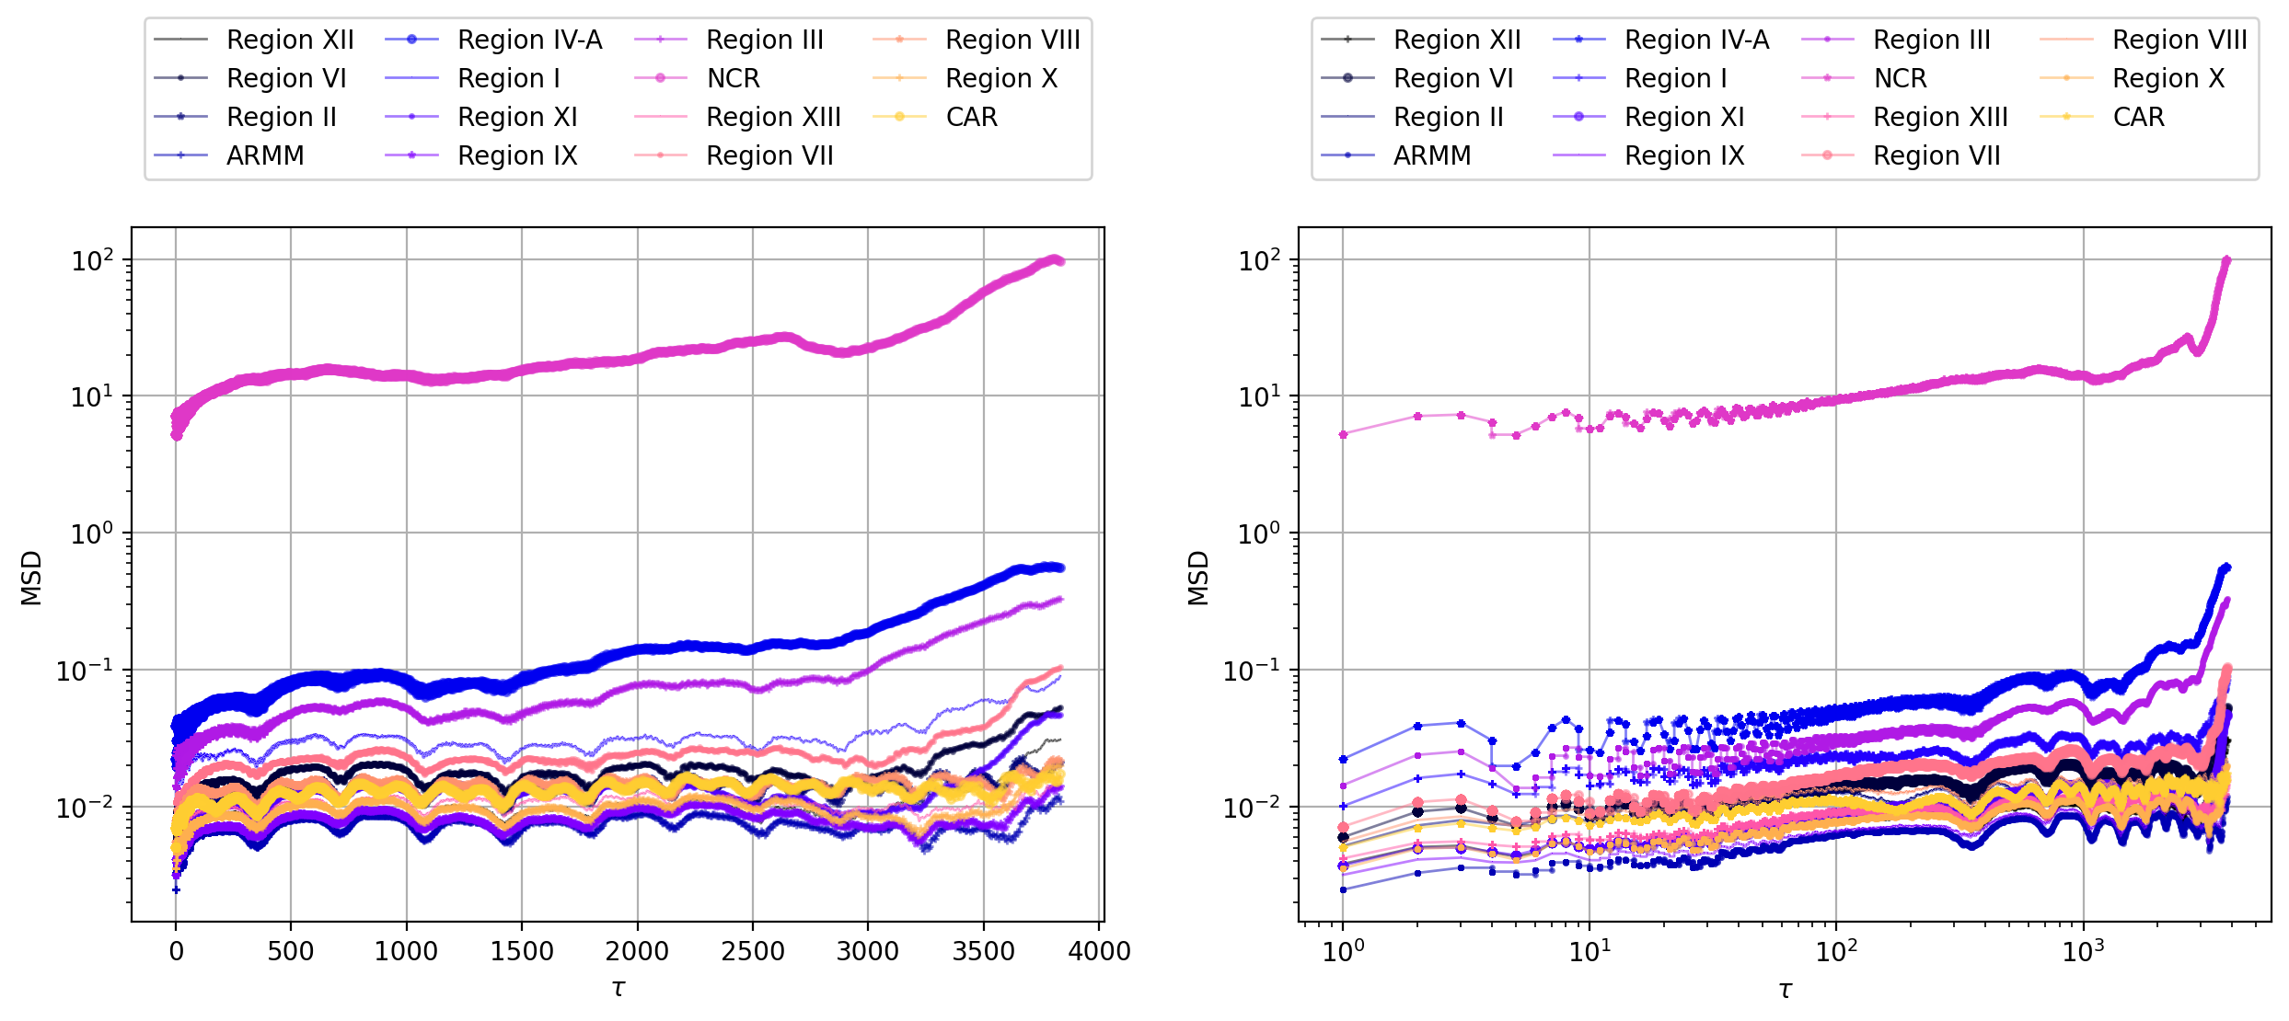
[MSD] Regional Monthly NTL

Slide 17
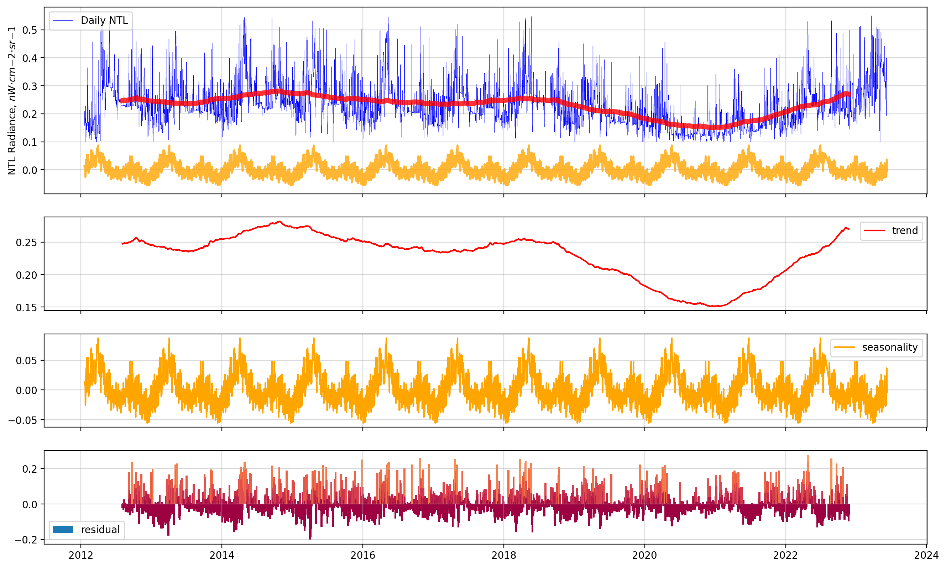
[STL] Decomposing NTL using LOESS

Slide 18
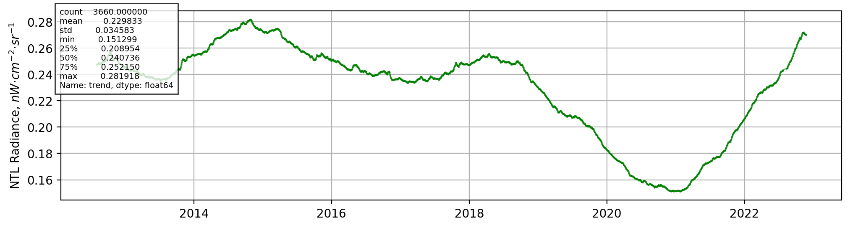
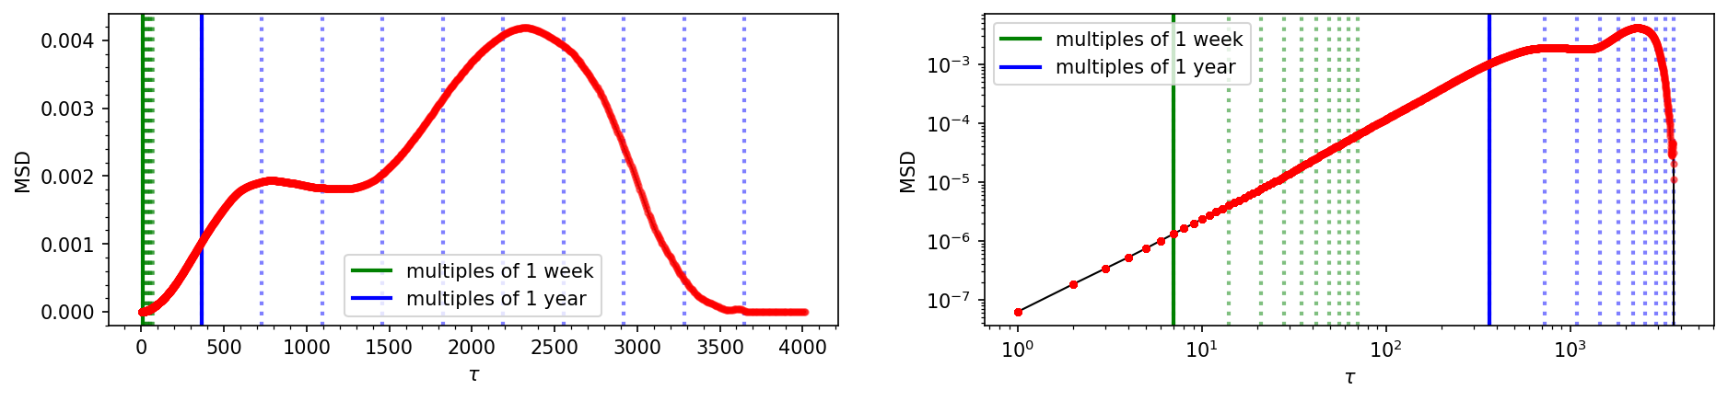
[MSD] NTL Trend of NCR

Slide 19
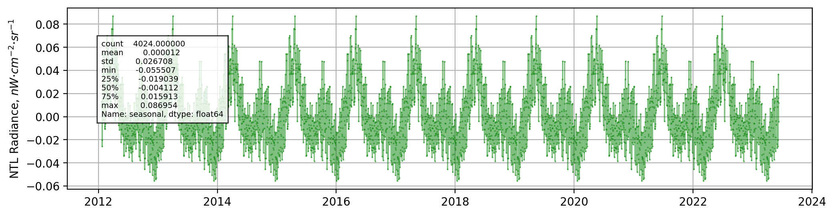
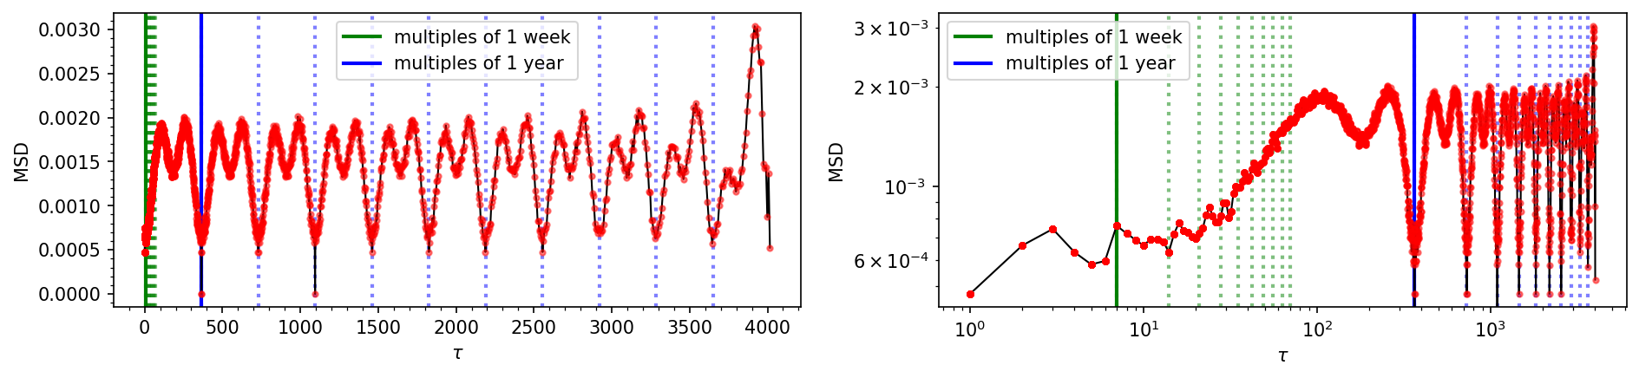
[MSD] NTL Seasonality of NCR

Slide 20
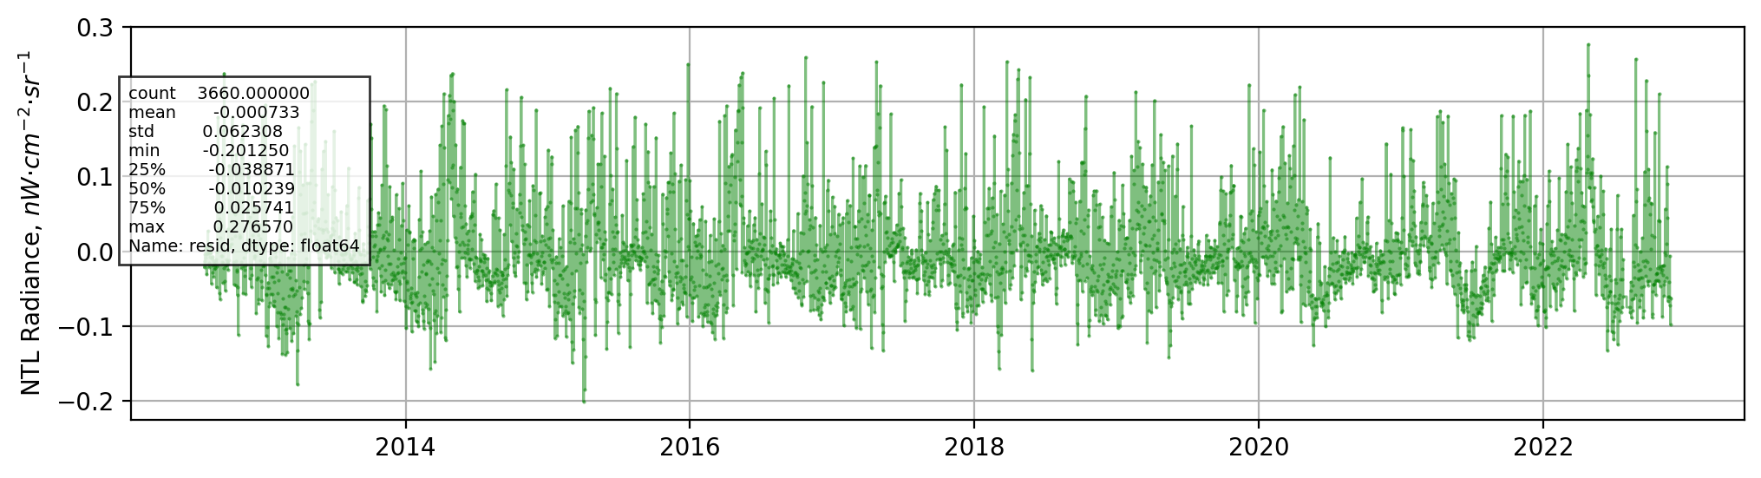
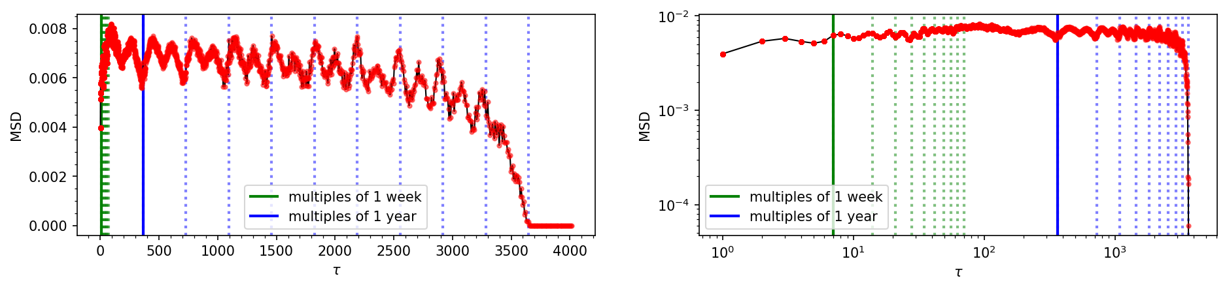
[MSD] NTL Residual of NCR

Slide 21
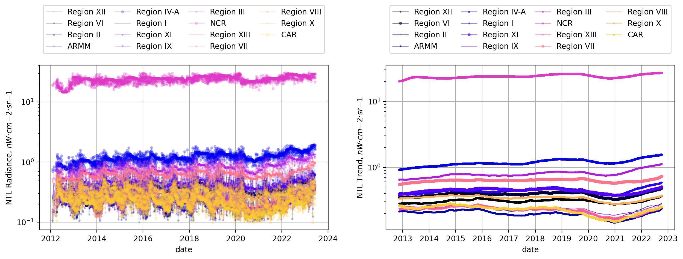
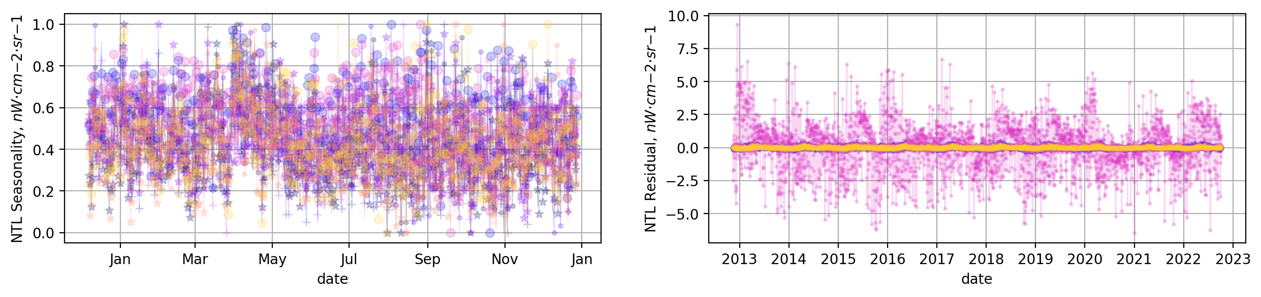
Regional NTL STL

Slide 22
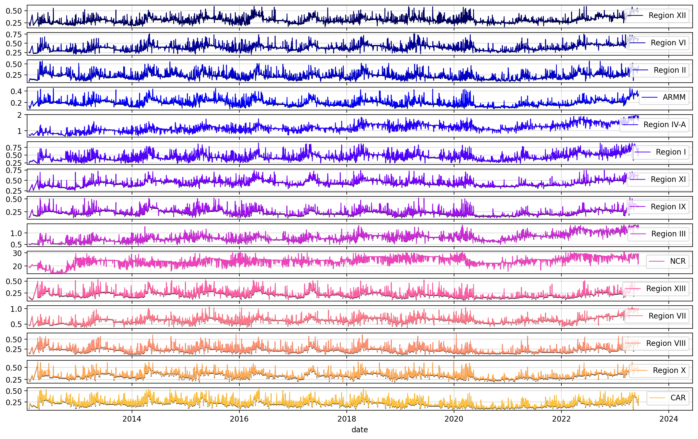
Regional Monthly Average NTL

Slide 23
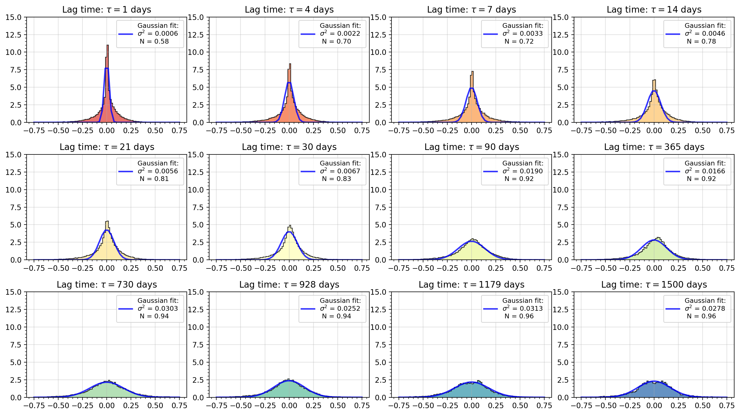
[PDF] Regional NTL raw values

Slide 24
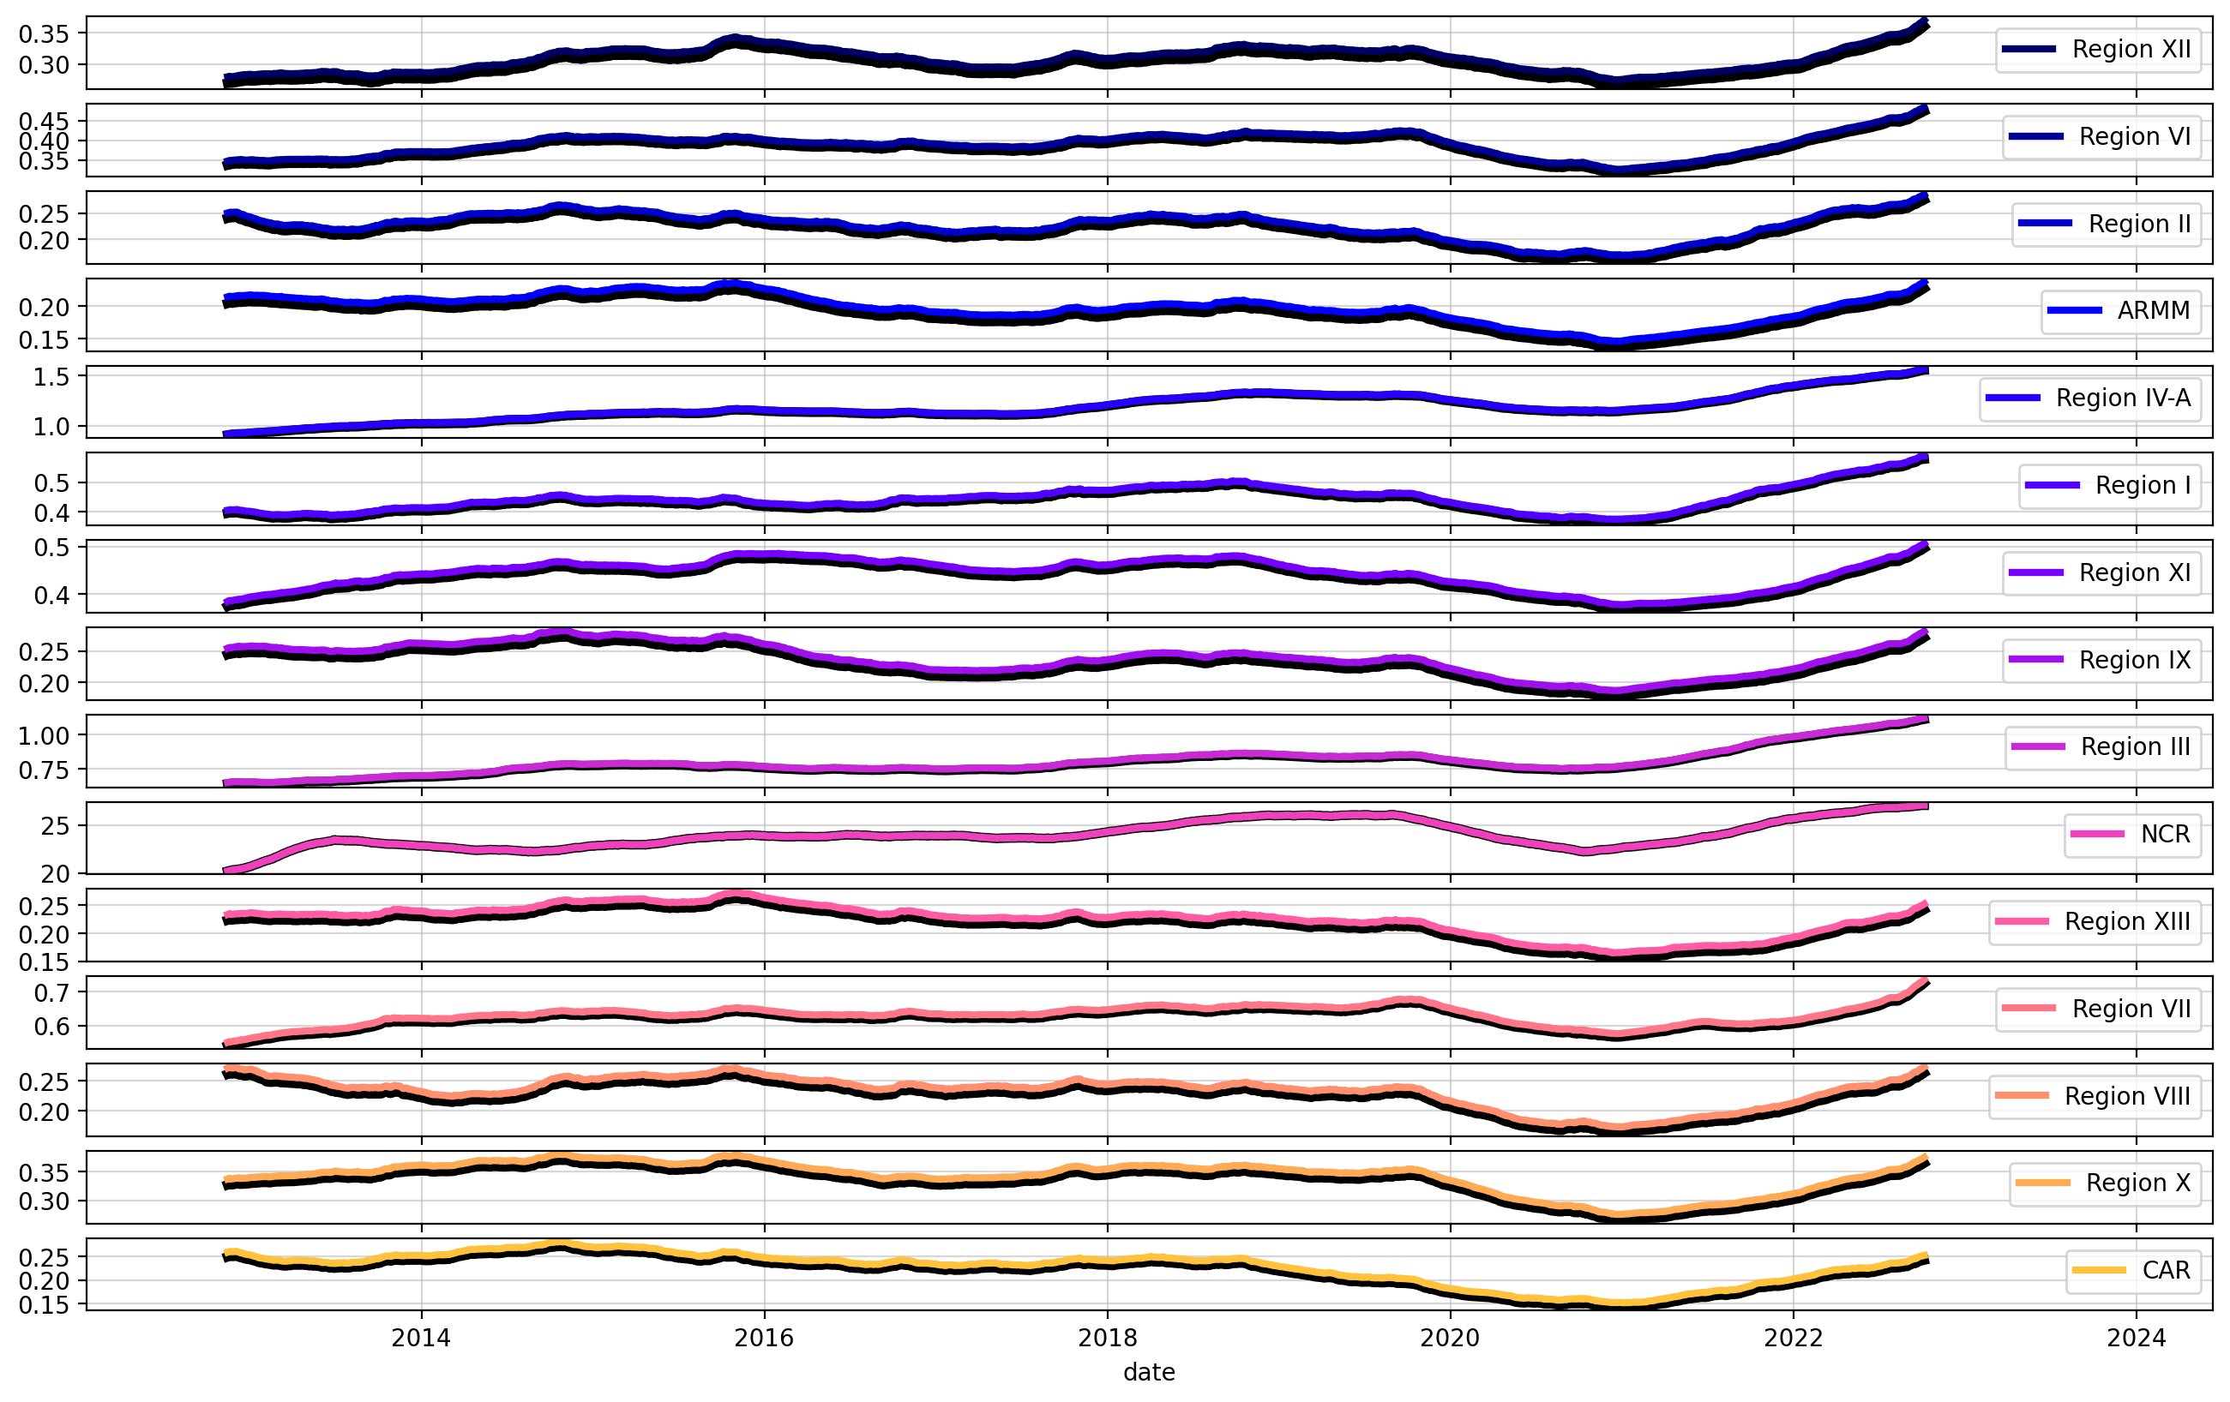
Regional NTL Trends

Slide 25
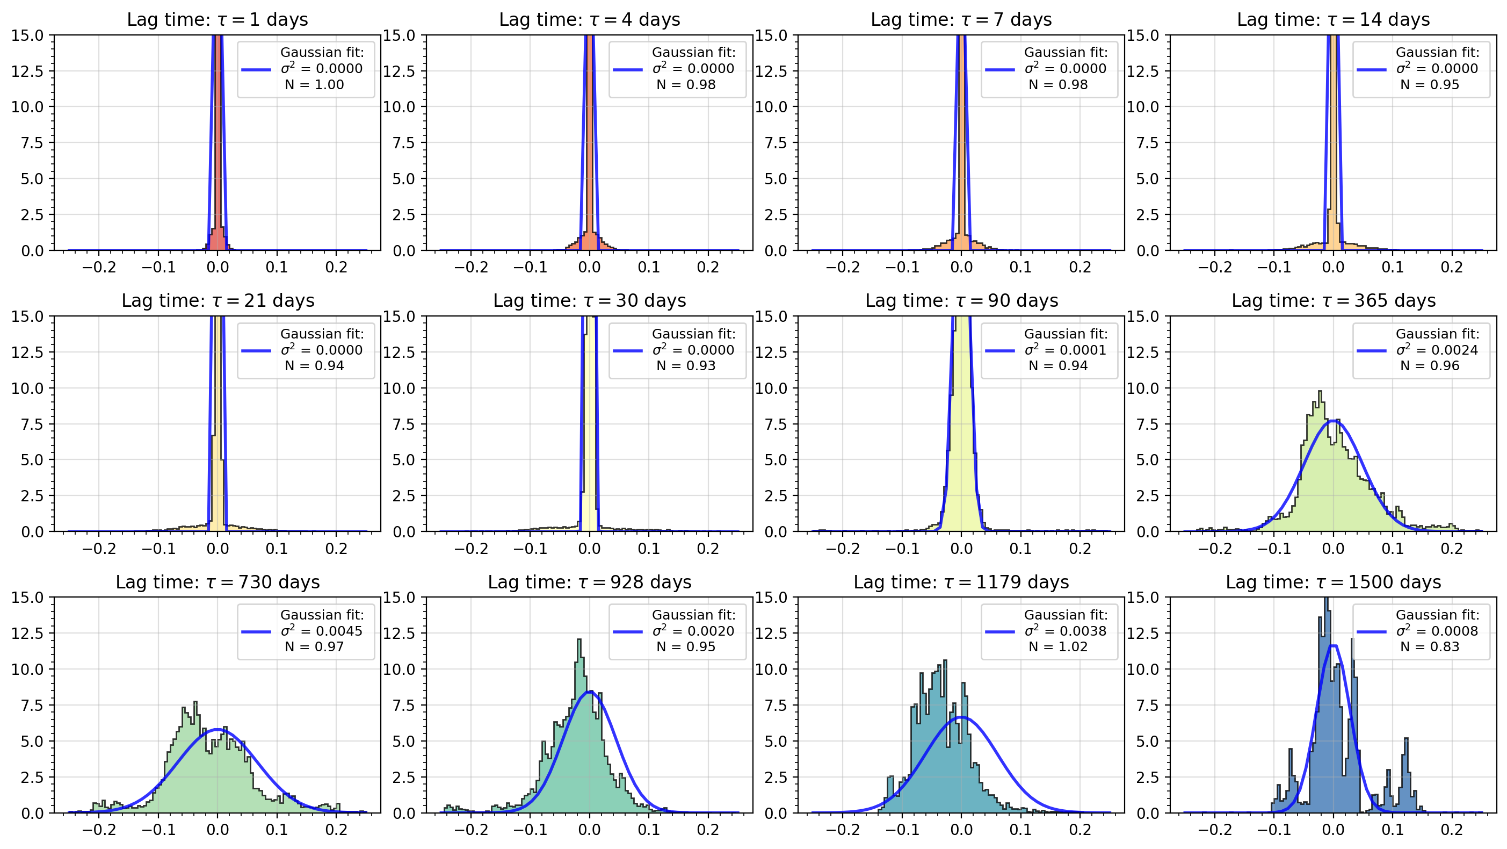
[PDF] Regional NTL Trends

Slide 26
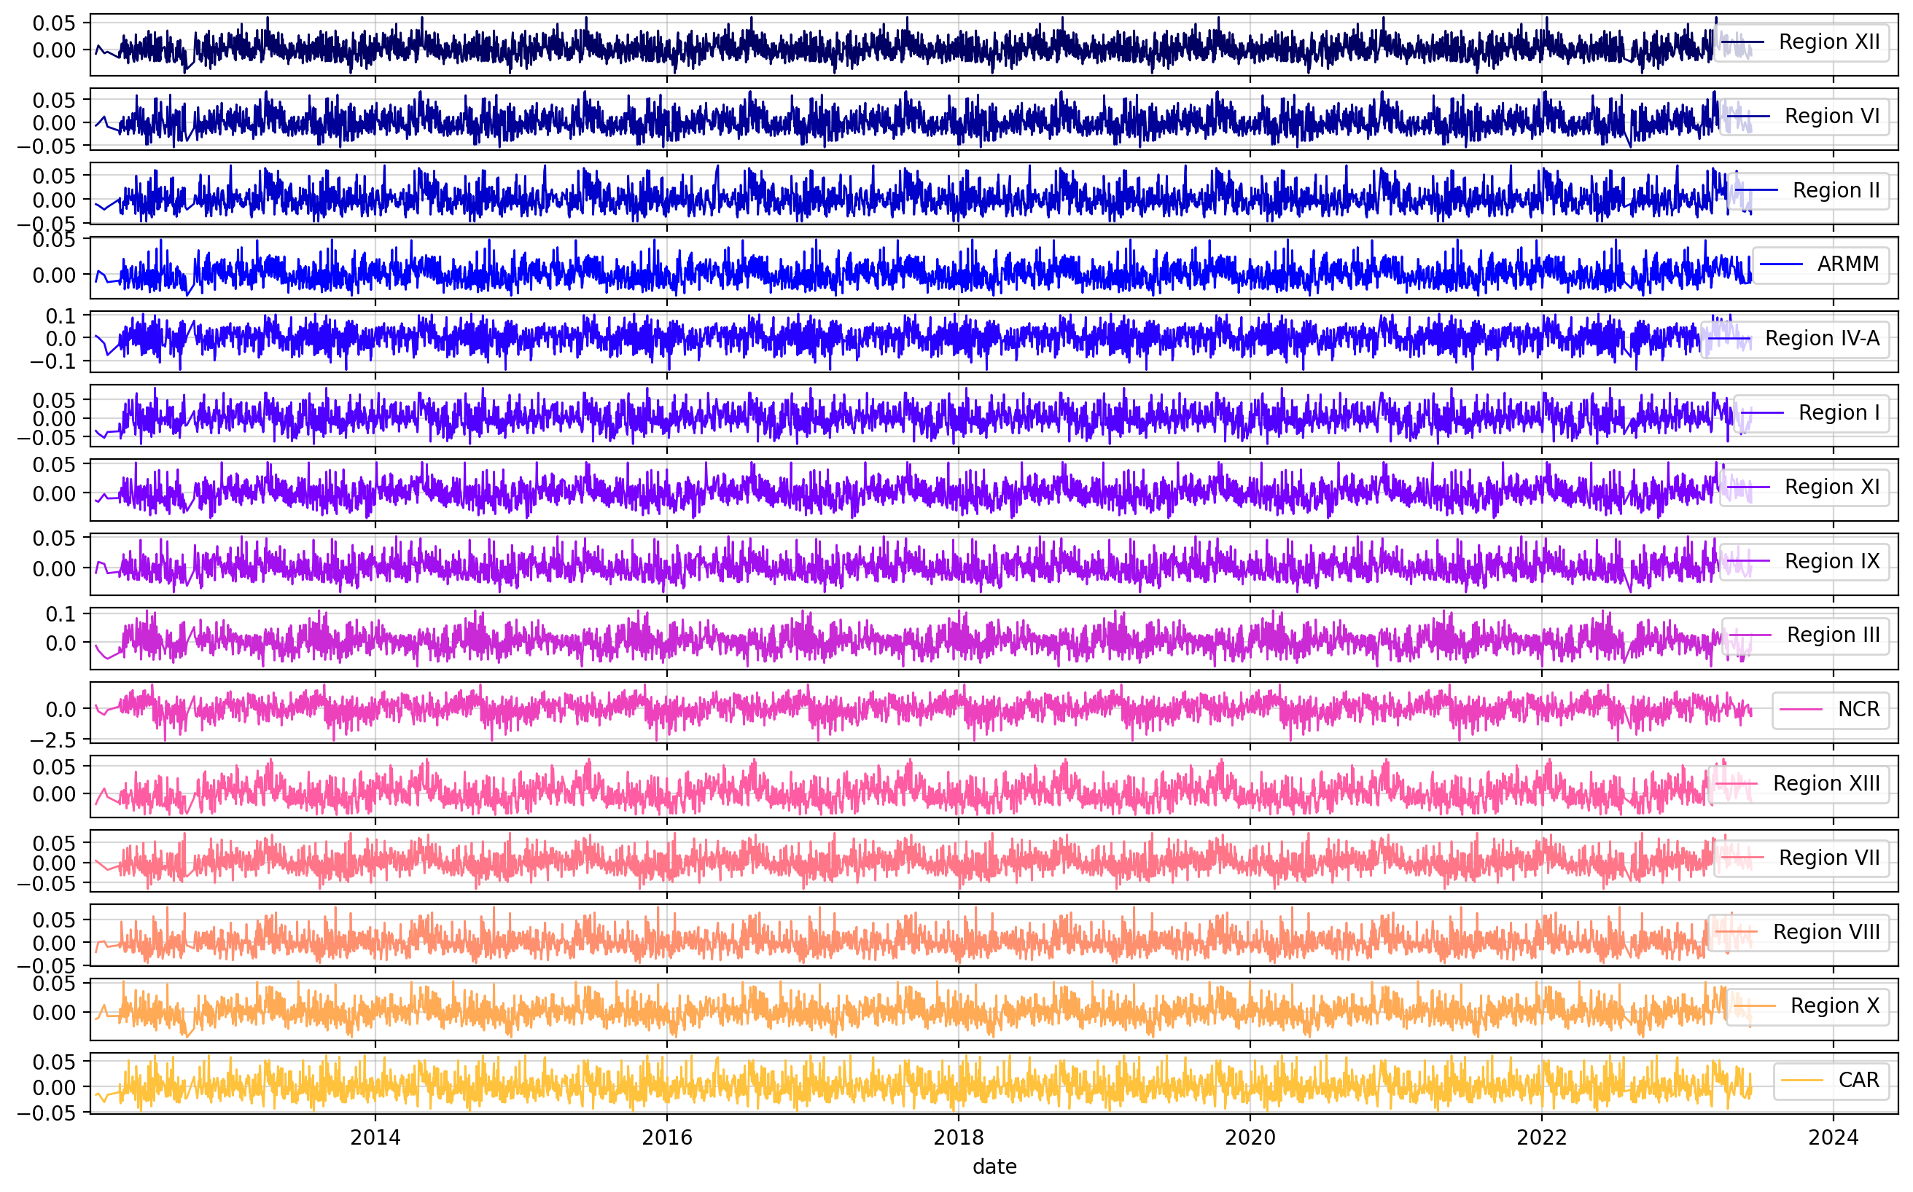
Regional NTL Seasonality

Slide 27
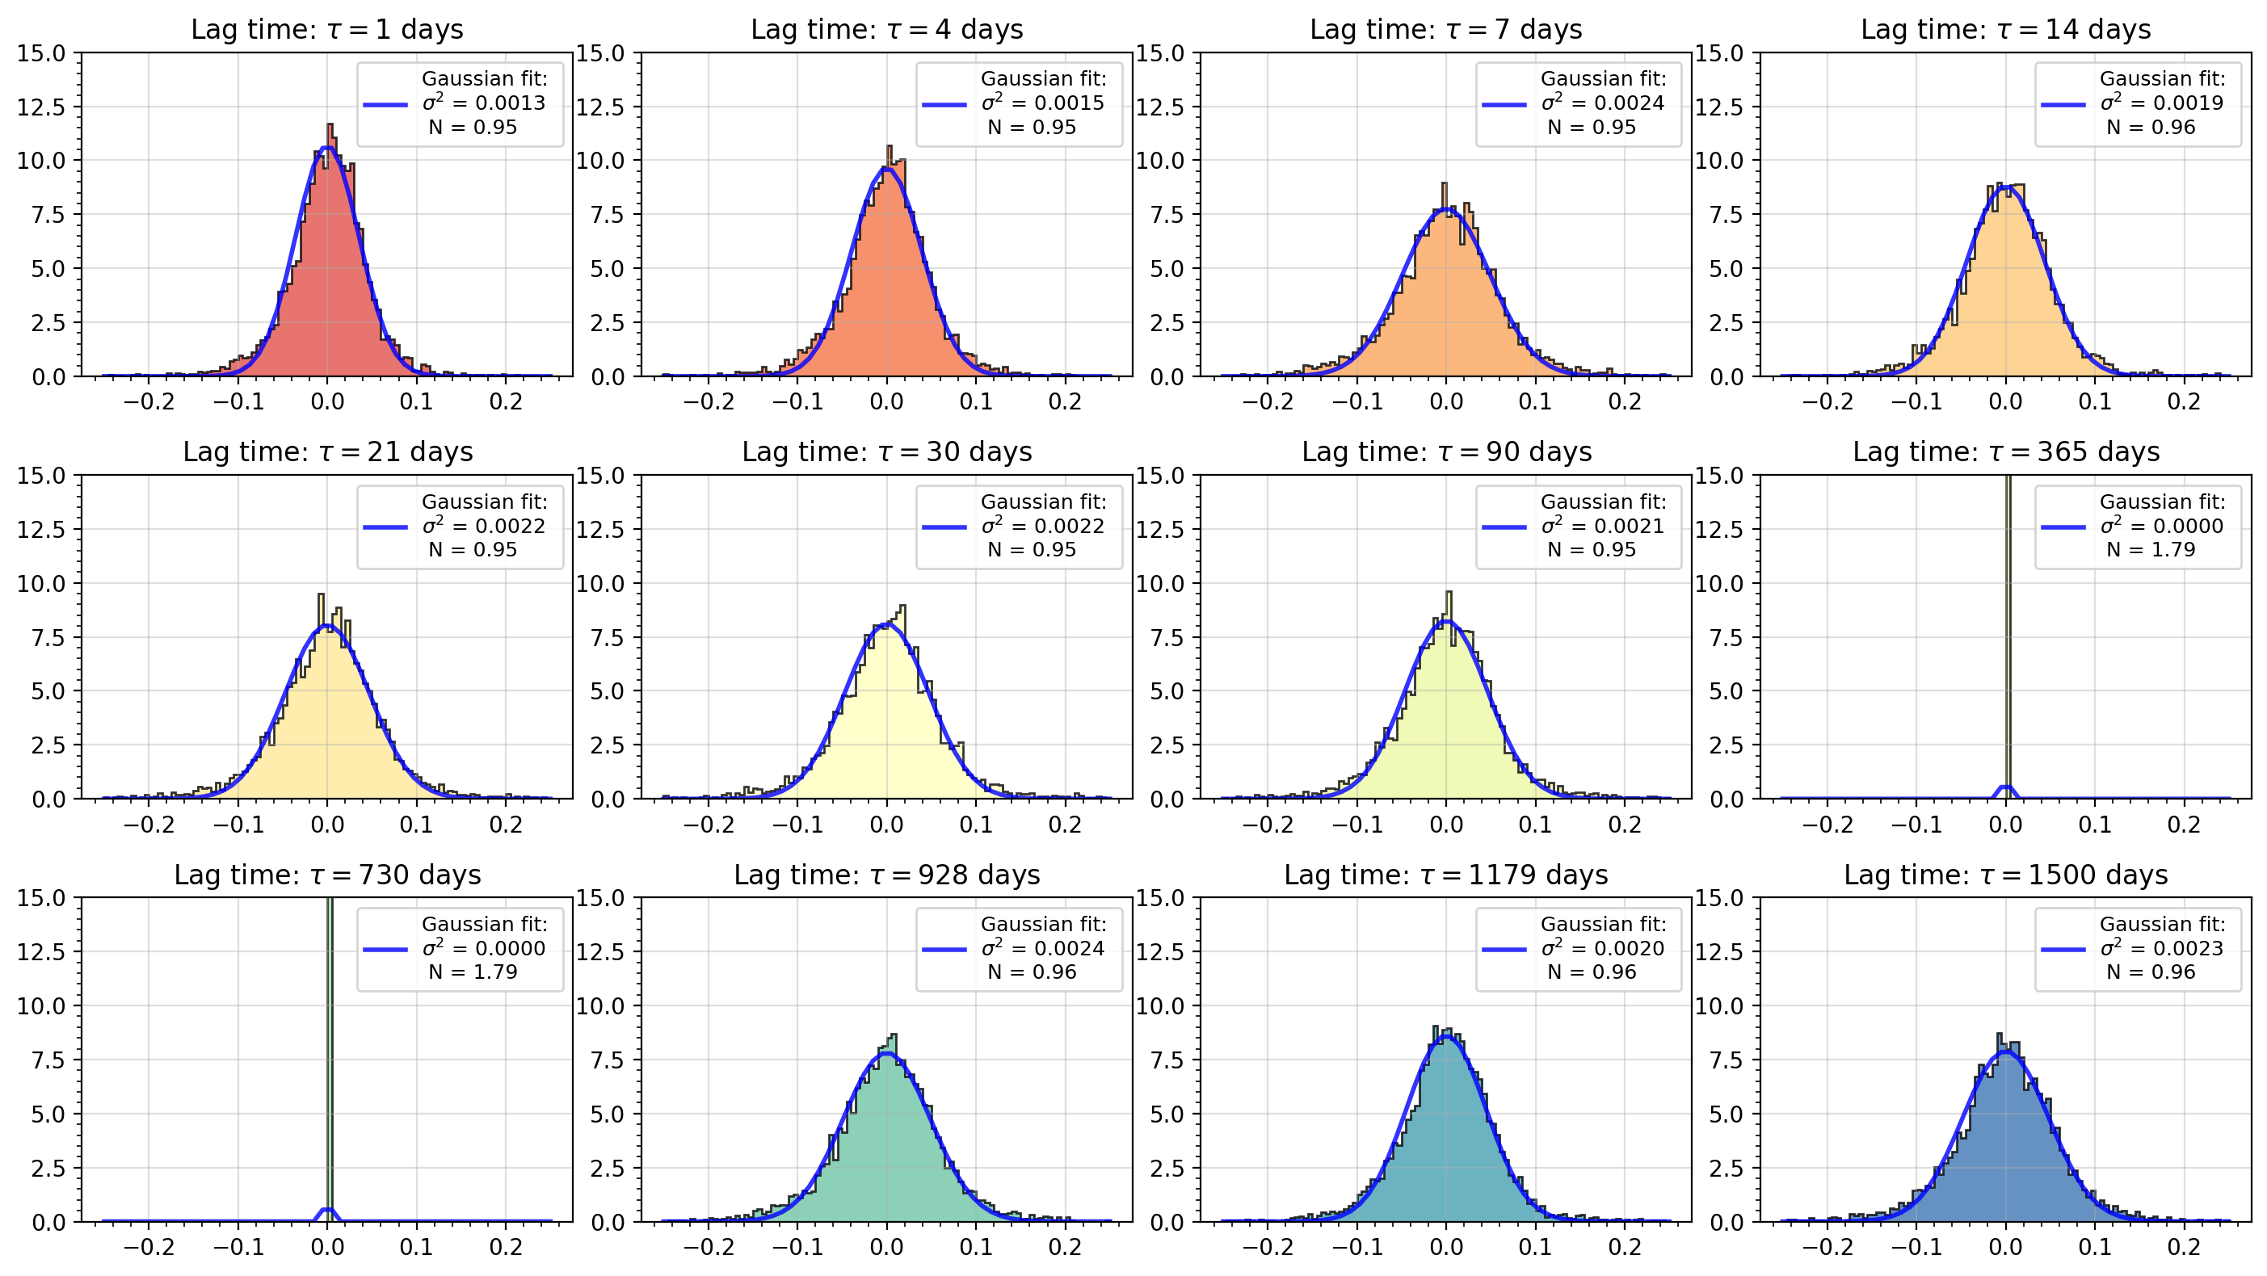
[PDF] Regional NTL Seasonality

Slide 28
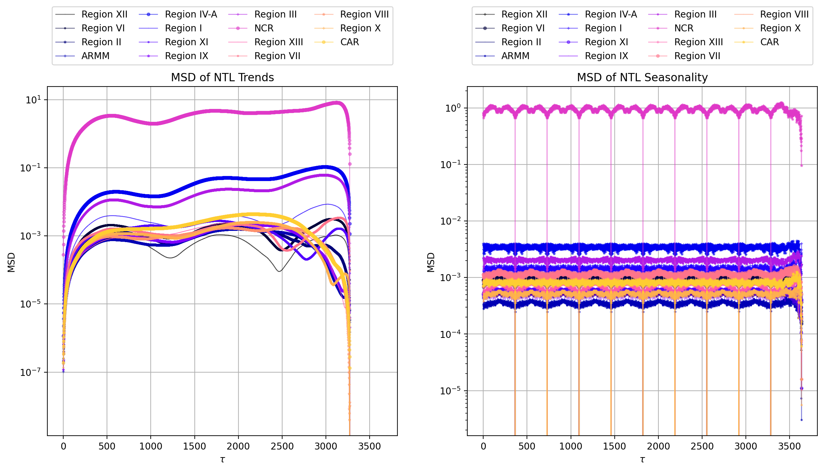
[MSD] NTL Trend and Seasonality

Slide 29
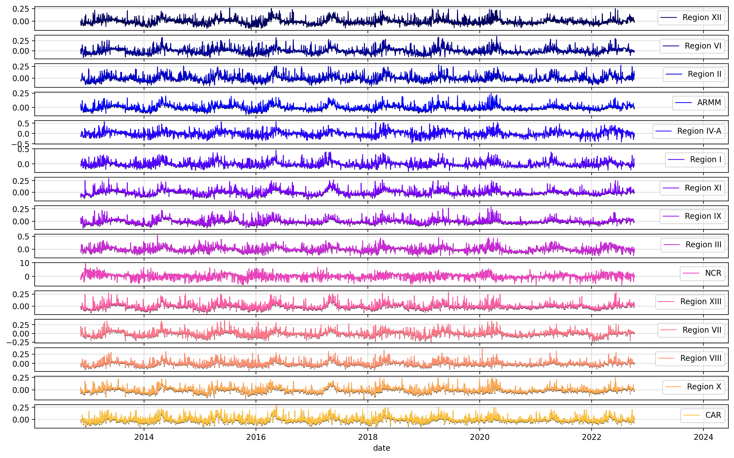
Regional NTL Residuals

Slide 30
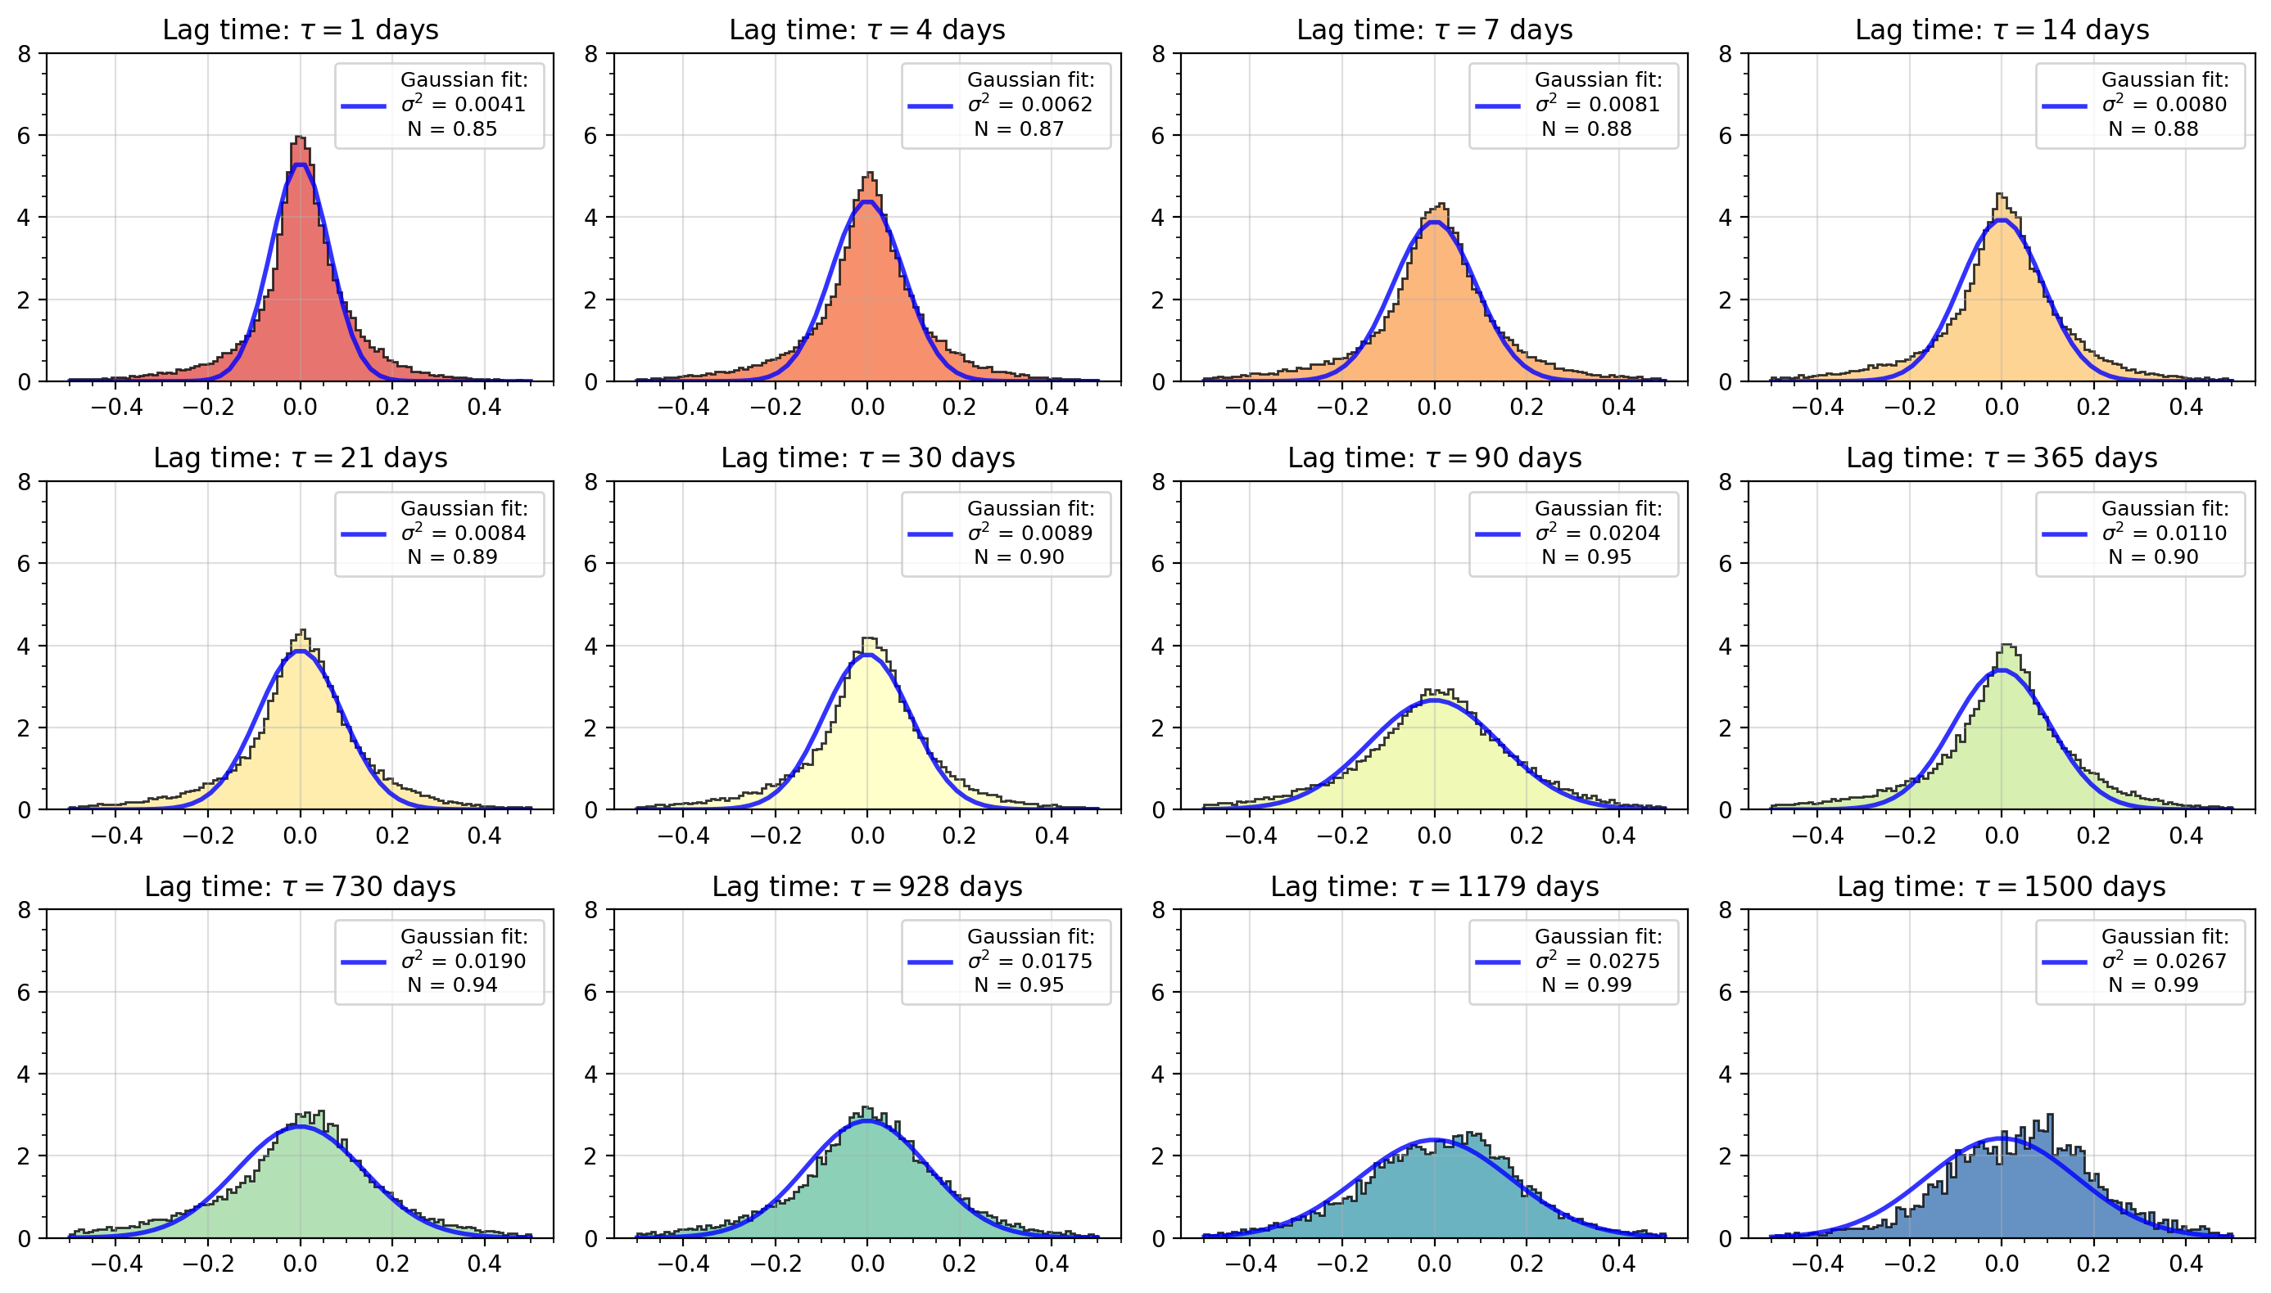
[PDF] Regional NTL Residuals

Slide 31
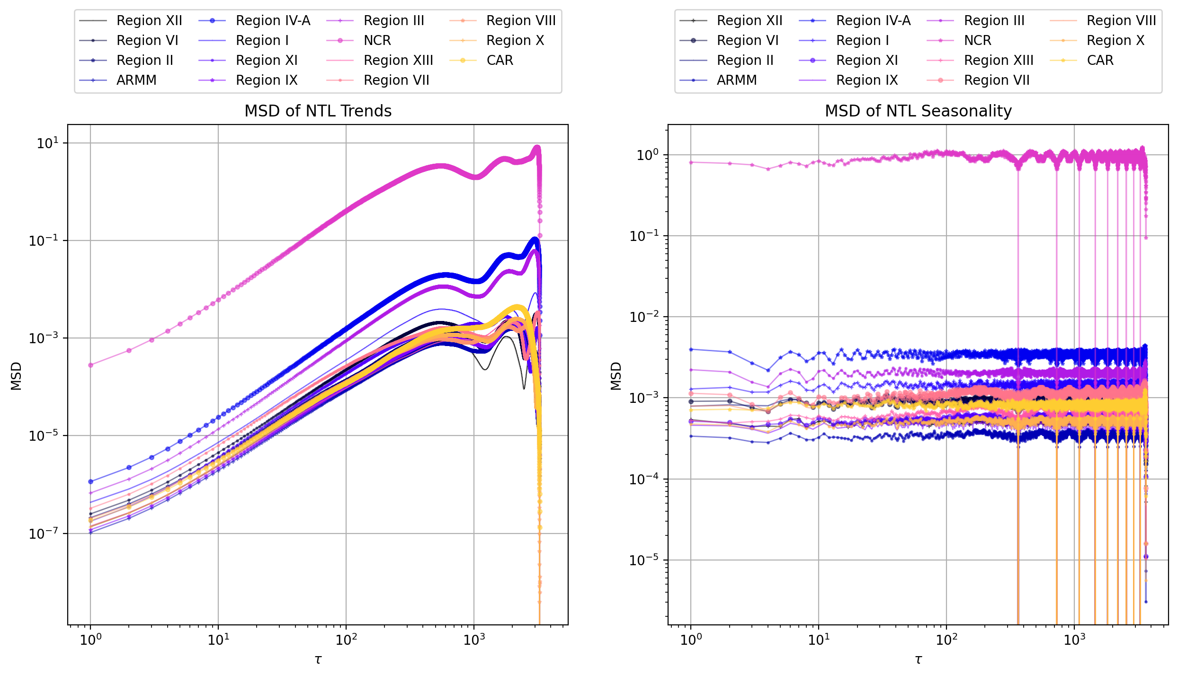
[MSD] NTL Trend and Seasonality

Slide 32
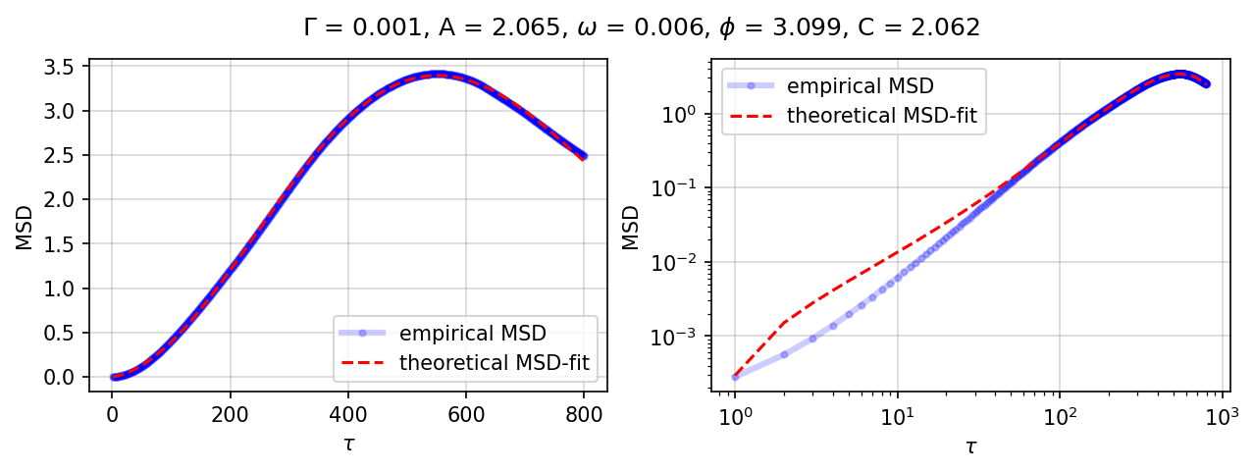
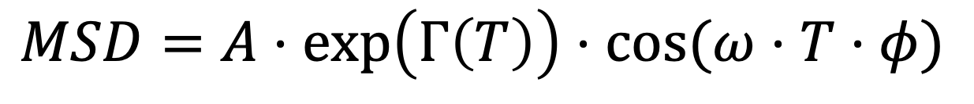
[MSD-1] Fitting Theoretical MSDs
$$MSD=A⋅\exp\left(Γ\left(T\right)\right)⋅cos⁡(ω⋅T⋅φ)$$

Slide 33
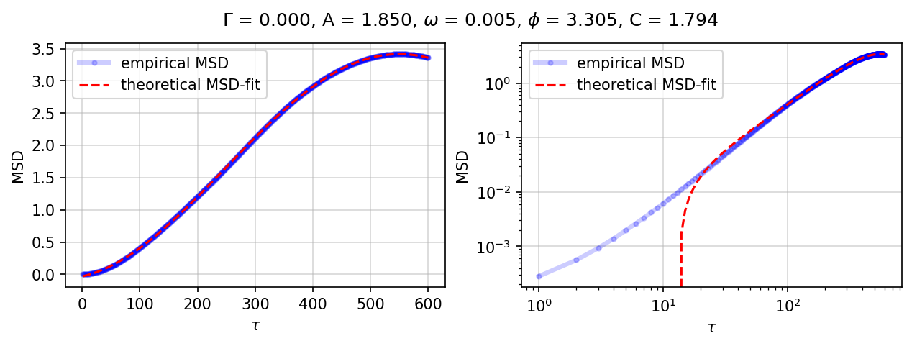
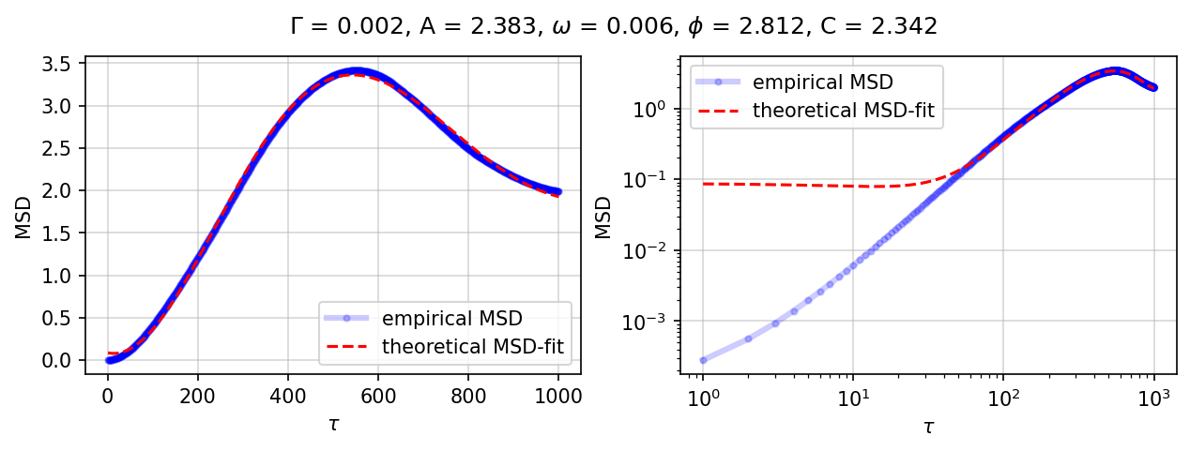
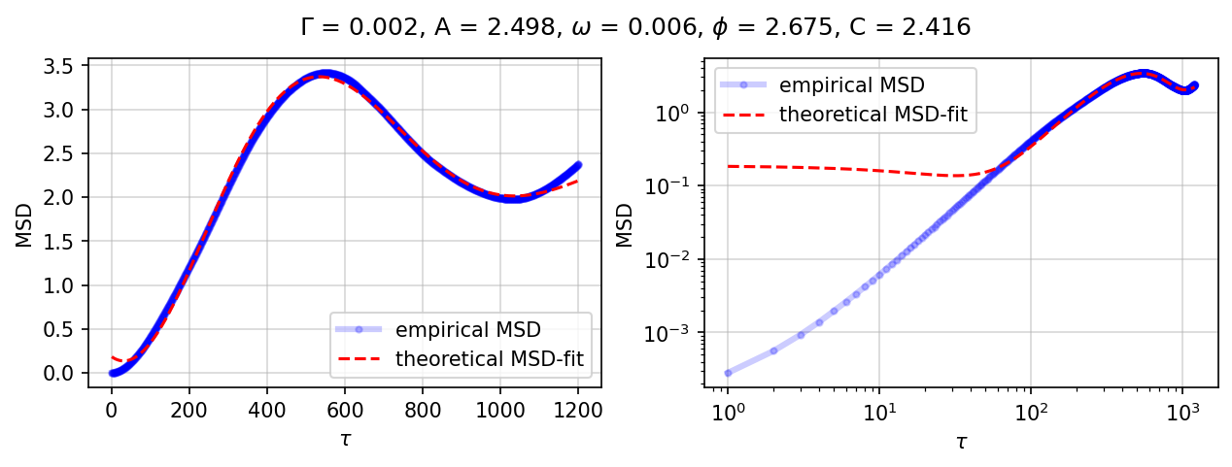
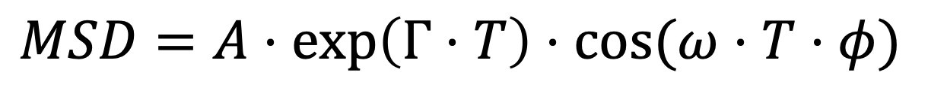
[MSD-1] Fitting Theoretical MSDs
$$MSD=A⋅\exp\left(Γ⋅T\right)⋅cos⁡(ω⋅T⋅φ)$$

Slide 34
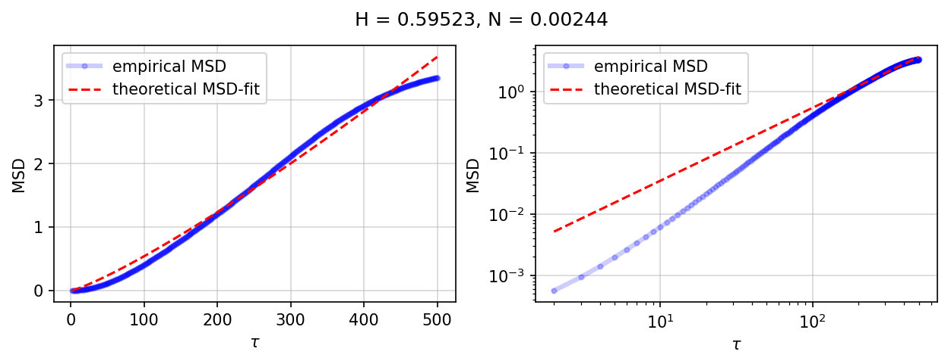
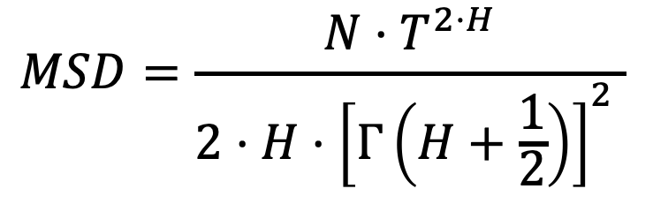
[MSD-2] Fitting Theoretical MSDs
$$MSD=\frac{N⋅T^{2⋅H}}{2⋅H⋅{\left[Γ\left(H+\frac{1}{2}\right)\right]}^{2} }$$

Slide 35
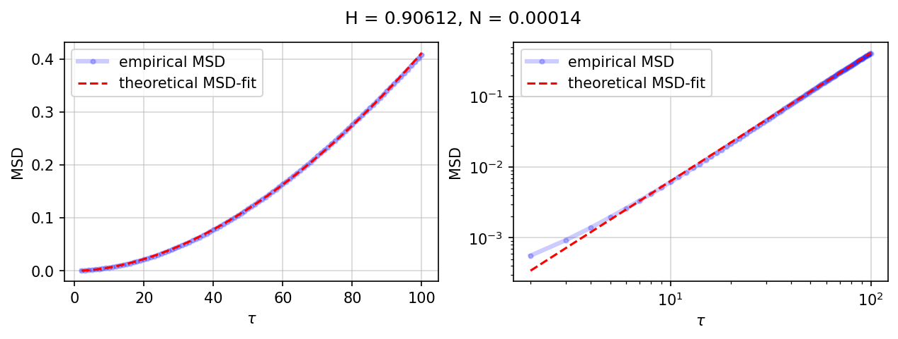
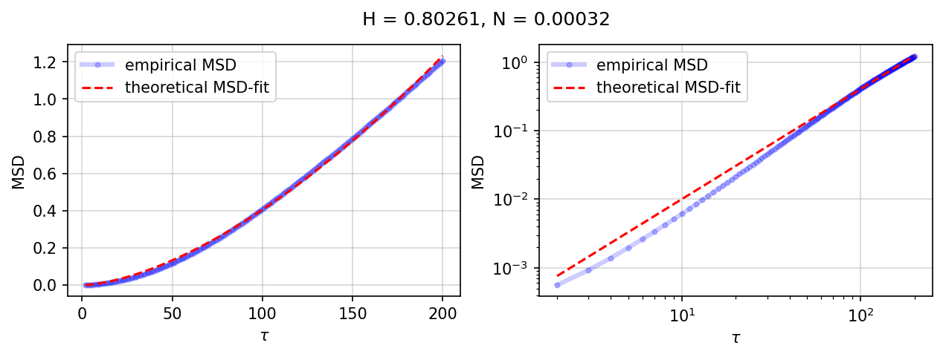
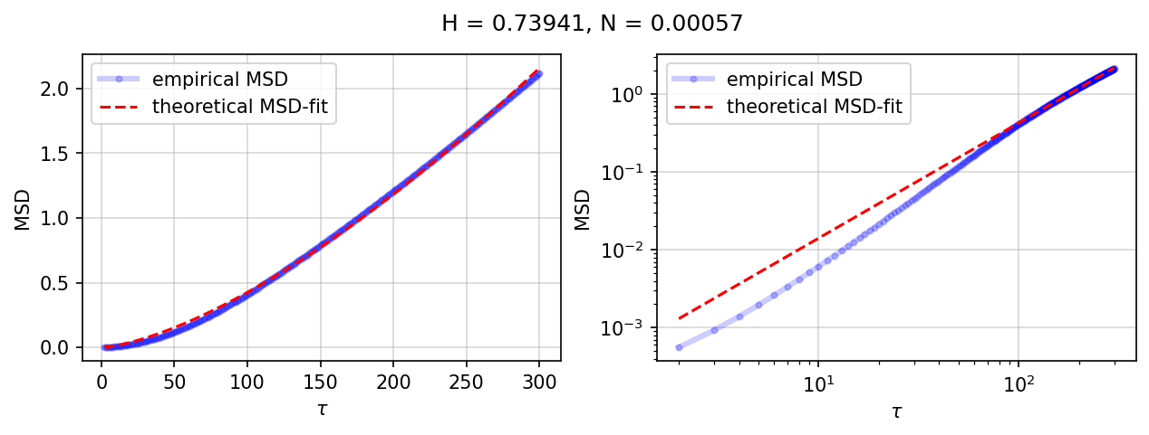
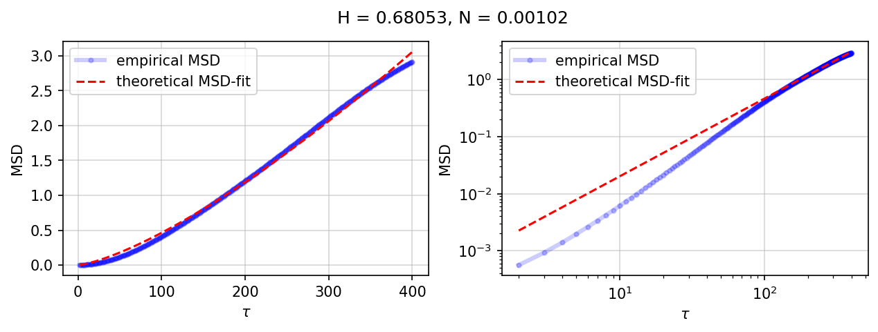
[MSD-2] Fitting Theoretical MSDs
$$MSD=\frac{N⋅T^{2⋅H}}{2⋅H⋅{\left[Γ\left(H+\frac{1}{2}\right)\right]}^{2} }$$
𝜏 = {100, 200, 300, 400}

Slide 36

[MSD-2] Fitting Theoretical MSDs
$$MSD=\frac{N⋅T^{2⋅H}}{2⋅H⋅{\left[Γ\left(H+\frac{1}{2}\right)\right]}^{2} }$$
𝜏 = {300, 400, 500, 600}

Slide 37

[MSD-2] Fitting Theoretical MSDs
$$MSD=\frac{N⋅T^{2⋅H}}{2⋅H⋅{\left[Γ\left(H+\frac{1}{2}\right)\right]}^{2} }$$

Slide 38


[FPTD-2] First Passage Time Density
$$MSD=\frac{N⋅T^{2⋅H}}{2⋅H⋅{\left[Γ\left(H+\frac{1}{2}\right)\right]}^{2} }, f\left(t\right)=−\frac{\left(x_{0}−x_{c}\right)}{\sqrt{2π}{\left[M\left(t\right)\right]}^{3}}\frac{∂M\left(t\right)}{∂t} exp \left[−\frac{{\left(x_{0}−x_{c}\right)}^{2}}{2M\left(t\right)}\right]$$
$$f\left(t\right)=2H \sqrt{\frac{c}{π}}\frac{1}{t^{H+1}}\left(x_{0}−x_{c}\right)exp \left[−\frac{{c\left(x_{0}−x_{c}\right)}^{2}}{t^{2H}}\right], c=HΓ{\left(H+\frac{1}{2}\right)}^{2}$$

Slide 39


[FPTD-2] First Passage Time Density
$$MSD=\frac{N⋅T^{2⋅H}}{2⋅H⋅{\left[Γ\left(H+\frac{1}{2}\right)\right]}^{2} }, f\left(t\right)=−\frac{\left(x_{0}−x_{c}\right)}{\sqrt{2π}{\left[M\left(t\right)\right]}^{3}}\frac{∂M\left(t\right)}{∂t} exp \left[−\frac{{\left(x_{0}−x_{c}\right)}^{2}}{2M\left(t\right)}\right]$$
$$f\left(t\right)=2H \sqrt{\frac{c}{π}}\frac{1}{t^{H+1}}\left(x_{0}−x_{c}\right)exp \left[−\frac{{c\left(x_{0}−x_{c}\right)}^{2}}{t^{2H}}\right], c=HΓ{\left(H+\frac{1}{2}\right)}^{2}$$

Slide 40

[FPTD-2] First Passage Time Density
$$MSD=\frac{N⋅T^{2⋅H}}{2⋅H⋅{\left[Γ\left(H+\frac{1}{2}\right)\right]}^{2} }, f\left(t\right)=−\frac{\left(x_{0}−x_{c}\right)}{\sqrt{2π}{\left[M\left(t\right)\right]}^{3}}\frac{∂M\left(t\right)}{∂t} exp \left[−\frac{{\left(x_{0}−x_{c}\right)}^{2}}{2M\left(t\right)}\right]$$
$$f\left(t\right)=2H \sqrt{\frac{c}{π}}\frac{1}{t^{H+1}}\left(x_{0}−x_{c}\right)exp \left[−\frac{{c\left(x_{0}−x_{c}\right)}^{2}}{t^{2H}}\right], c=HΓ{\left(H+\frac{1}{2}\right)}^{2}$$

Slide 41



Slide 42


[MSD-3] Fitting Theoretical MSDs
$$MSD=\frac{Γ\left(μ\right)⋅\cos\left(vT/2\right)⋅J_{μ−\frac{1}{2}} \left(vT/2\right)}{π^{−\frac{1}{2}}{⋅ T}^{\frac{1}{2} −μ}⋅v^{μ−\frac{1}{2}}}$$

Slide 43




[MSD-3] Fitting Theoretical MSDs
$$MSD=\frac{Γ\left(μ\right)⋅\cos\left(vT/2\right)⋅J_{μ−\frac{1}{2}} \left(vT/2\right)}{π^{−\frac{1}{2}}{⋅ T}^{\frac{1}{2} −μ}⋅v^{μ−\frac{1}{2}}}$$

Slide 44





[MSD-3] Fitting Theoretical MSDs
$$MSD=\frac{Γ\left(μ\right)⋅\cos\left(vT/2\right)⋅J_{μ−\frac{1}{2}} \left(vT/2\right)}{π^{−\frac{1}{2}}{⋅ T}^{\frac{1}{2} −μ}⋅v^{μ−\frac{1}{2}}}$$
GBR
CO₂
SST

Slide 45



[MSD-3] Fitting Theoretical MSDs
$$MSD=\frac{Γ\left(μ\right)⋅\cos\left(vT/2\right)⋅J_{μ−\frac{1}{2}} \left(vT/2\right)}{π^{−\frac{1}{2}}{⋅ T}^{\frac{1}{2} −μ}⋅v^{μ−\frac{1}{2}}}$$

Slide 46



Slide 47


Slide 48


Slide 49


$$x\left(T\right)=x_{0}+\int_{0}^{T}{{\left(T−t\right)}^{\frac{ μ−1}{2}}}t^{\frac{ μ−1}{2}}\sqrt{\cos\left(vt\right)dB\left(t\right)}$$
$$MSD=\frac{Γ\left(μ\right)⋅\cos\left(vT/2\right)⋅J_{μ−\frac{1}{2}} \left(vT/2\right)}{π^{−\frac{1}{2}}{⋅ T}^{\frac{1}{2} −μ}⋅v^{μ−\frac{1}{2}}}$$
Notes:
“Stochastic process loses its dependence on the memory function, (T − t)( −1)∕2 , at the critical value of mu= 1.”

Slide 50

First Passage Time Density
$$MSD=\frac{Γ\left(μ\right)⋅\cos\left(vT/2\right)⋅J_{μ−\frac{1}{2}} \left(vT/2\right)}{π^{−\frac{1}{2}}{⋅ T}^{\frac{1}{2} −μ}⋅v^{μ−\frac{1}{2}}}$$
$$f\left(t\right)=−\frac{\left(x_{0}−x_{c}\right)}{\sqrt{2π}{\left[M\left(t\right)\right]}^{3}}\frac{∂M\left(t\right)}{∂t} exp \left[−\frac{{\left(x_{0}−x_{c}\right)}^{2}}{2M\left(t\right)}\right]$$
Notes:
Sure, let's apply the expression for \(\frac{\partial MSD}{\partial T}\) to the given function \(f(t)\):
\[ f(t) = -\frac{(x_0 - x_c)}{\sqrt{2\pi} \cdot [M(t)]^3} \cdot \frac{\partial MSD}{\partial T} \cdot \exp\left[-\frac{(x_0 - x_c)^2}{2M(t)}\right] \]
Now, plug in the expression for \(\frac{\partial MSD}{\partial T}\) into \(f(t)\):
\[ f(t) = -\frac{(x_0 - x_c)}{\sqrt{2\pi} \cdot [M(t)]^3} \cdot \left(\frac{\Gamma'(\mu) \cdot \cos\left(\frac{vT}{2}\right) \cdot J_{(\mu-1/2)}\left(\frac{vT}{2}\right)}{\sqrt{\pi} \cdot T^{1/2 - \mu} \cdot v^{\mu-1/2}} - \frac{\Gamma(\mu) \cdot \cos\left(\frac{vT}{2}\right) \cdot J_{(\mu-1/2)}\left(\frac{vT}{2}\right) \cdot (1/2) \cdot T^{-3/2 - \mu}}{\sqrt{\pi} \cdot v^{\mu-1/2}}\right) \cdot \exp\left[-\frac{(x_0 - x_c)^2}{2M(t)}\right] \]
This expression captures the partial derivative of the given \(f(t)\) with respect to time \(T\), incorporating the expression for \(\frac{\partial MSD}{\partial T}\).

Slide 51

First Passage Time Density

Slide 52

First Passage Time Density

Slide 53


NTL and Poverty
Asset vs Nighttime Lights | Neal Jean et al. Combining satellite imagery and machine learning to predict poverty. Science, 353:790–794, 2016.

Slide 54




NTL and Poverty
NTL-based Poverty Mapping in PH | Isabelle Tingzon et al. Mapping Poverty in the Philippines Using Machine Learning, Satellite Imagery, and Crowd-sourced Geospatial Information. The International Archives of the Photogrammetry, Remote Sensing and Spatial Information Sciences, XLII:14–15, 2019.

Slide 55




NTL and Urbanization
Urban Mapping using NTL and ancillary data | Xu, T., Coco, G., & Gao, J. Extraction of urban built-up areas from nighttime lights using artificial neural network. Geocarto International, 35(10), 1049–1066., 2020

Slide 56


NTL and Urbanization
CNN-based urban expansion mapping | Chunyang He et al. Detecting global urban expansion over the last three decades using a fully convolutional network. Environmental Research Letters, 14, 2019.

Slide 57


Relevant studies using NTL
Why use nighttime lights?.
NTL provides improved accessibility to information difficult to obtain by other means.
NTL is consistent, has a wide geographic coverage and high spatiotemporal resolution.
NTL are especially useful for a variety of socio-economic research and applications.
Neal Jean et al. Combining satellite imagery and machine learning to predict poverty. Science, 353:790–794, 2016.
Isabelle Tingzon et al. Mapping Poverty in the Philippines Using Machine Learning, Satellite Imagery, and Crowd-sourced Geospatial Information. The International Archives of the Photogrammetry, Remote Sensing and Spatial Information Sciences, XLII:14–15, 2019.
Xi Chen and William D. Nordhaus. Using luminosity data as a proxy for economic statistics. Proceedings of the National Academy of Sciences of the United States of America, 108:8589–8594, 2011.
Christopher D Elvidge et al. Night-time lights of the world: 1994–1995. ISPRS Journal of Photogrammetry and Remote Sensing, 56(2):81–99, 2001.
Notes:
An extensive set of relevant literature has established a striking correlation between NTL and socioeconomic indicators citing that it can detect human-induced changes on the ground both in short- and long-term timescales [10].

Slide 58

NTL and Public Health

Slide 59

NTL and Public Health

Slide 60

NTL and Public Health

Slide 61

NTL and Public Health

Slide 62
Appendix: Future work
Integration of Level 3/4 Administrative Shape Files
Extending NDWE Analysis for Disaster Management:
Addressing the Impact of Spectral Shift in Street Lighting
| The Berlin Divide (2020) |
https://twitter.com/NorbertElekes/status/1325892921590210560/photo/1

Slide 63

Spectral Response Functions
Nikon D3s Cameras used by the astronauts at the ISS
Metal Halide lamp, popular on architectural lights
High pressure sodium (HPS) light, popular until 2014 on street lighting
LEDs of 5000K (blue), 4000K (cyan), 2700K (grey), and PC-Amber (amber), popular on street lighting
Representative spectral response of DMSP/OLS(black) and Suomi-NPP/VIIRS/DNB(blue)

Slide 64
Challenges of Spectral Shift
NTL sensors are panchromatic. Though the bandwidths have been broad, they have also been insensitive to the blue part of the visible spectrum (380 to 450 nm);

Slide 65
Challenges of Spectral Shift
Outdoor lighting is transitioning from low-pressure sodium (narrow spectrum) to LED lamps (broad-white spectrum), essentially increasing the blue-light emissions.
Notes:
Satellite-borne imagery may provide a poor or limited quantitative indicator of the exposure to environmental risks associated with ALAN, as shifts toward potentially harmful lower-wavelength emissions are masked by the low sensitivity of the sensors at these wavelengths.

Slide 66


Challenges of Spectral Shift
From a biological perspective:
ALAN has been found to affect individual physiology and behavior (including that of humans) to community structure and ecosystem function. For example, melatonin suppression is particularly sensitive to those at blue wavelengths.

Slide 67

Rebound effect (Jevon’s Paradox)
Low cost and high-power efficiency of LED have driven increased demand for lighting, and hence, any efficiency gains have been counteracted by increased consumption of light.
London, UK: 51% conversion to LED by 2019

Slide 68


Transition to LED lighting
Milan, Italy: first total conversion to white LED (2012 vs 2015)
Madrid, Spain: 56% conversion to LED (2012 vs 2017)
Notes:
Italy; Milan (2012 vs 2015) was the first mayoral city in Europe to undertake a total conversion of its street lighting to white LEDs (Fig. 4) (18). In the United Kingdom, 51% of all public street lighting was already converted to LEDs by early 2019 (23), and in Spain, LEDs were 61% of all sales and 56% of the street lighting by 2017 (2012 vs 2017).

Slide 69

Appendix: VIIRS Boat Detection
https://www.mecreeled.com/wp-content/uploads/2019/03/fishing-light-led.jpg

Slide 70


Appendix: VIIRS Boat Detection

Slide 71

https://globalfishingwatch.org/data/ais-viirs-reveals-dark-fleet/
intense fishing activity off southeast and east Asia

Slide 72

Skill building via GEE (~1 month)
https://worldbank.github.io/OpenNightLights/wb-light-every-night-readme.html

Slide 73

Skill building via GEE

Slide 74
Main References
M. O. Roman, E. C. Stokes, R. Shrestha, Z. Wang, L. Schultz, E. A. Sepulveda Carlo, Q. Sun, J. Bell, A. Molthan, V. Kalb, et al., Satellite-based assessment of electricity restoration efforts in Puerto Rico after Hurricane Maria, PLoS ONE 14 (2019).
NASA’s Black Marble nighttime lights product suite, Remote Sens. Environ. 210, 113 (2018).
C. D. Elvidge, K. Baugh, M. Zhizhin, F. C. Hsu, and T. Ghosh, VIIRS night-time lights, Int. J. Remote Sens. 38, 5860 (2017).
M. Zhao, Y. Zhou, X. Li, W. Cao, C. He, B. Yu, X. Li, C. D. Elvidge, W. Cheng, and C. Zhou, Applications of satellite remote sensing of nighttime light observations: Advances, challenges, and perspectives, Remote Sensing 11, 1 (2019).
Japan International Cooperation Agency, Republic of the Philippines Data Collection Survey on the Incentive Mechanism for Improving Disaster Resiliency of Electric Power Distribution Network Final Report, October 2015.
M. V. S. Villanueva, Challenges and opportunities for sustainable post- disaster resettlement in the Philippines (2018), https://www.preventionweb.net/publication/challenges-and-opportunities-sustainable-post-disaster-resettlement-philippines.

Slide 75


Skill building via GEE

Slide 77



Slide 78



Slide 79



Slide 80



Slide 81

BRDF Correction

Slide 82

BRDF Correction
L_{m} : the spectral radiance contribution from moonlight
𝑓_{𝑖𝑠𝑜} (Ʌ) : isotropic scattering component and equal to the bidirectional reflectance for a pixel viewing zenith angle 𝜃_{𝑣} = 0 and a lunar zenith angle 𝜃_{𝑚} = 0.
𝑓_{𝑔𝑒𝑜} (Ʌ) : coefficient of the LiSparse-Reciprocal geometric scattering kernel Kgeo, derived for a sparse ensemble of surface casting shadows on a Lambertian background
𝑓_{𝑣𝑜𝑙} (Ʌ) : coefficient for the RossThick volume scattering kernel Kvol, so called for its assumption of a dense leaf canopy
$Δφ$ : relative view-sun azimuth angle ($Δφ=φ_{m} −φ_{v}$) and ξ is the scattering phase angle between moon and view directions.
E_{m} (Ʌ) [units of nW·m-2] : downwelling TOA sensor response function-weighted lunar irradiance (Miller and Turner, 2009), and BRF is the surface bidirectional reflectance factor – the ratio of the BRDF to that of a perfect Lambertian reflector (i.e., BRF ~ BRDF)
Notes:
To achieve a high-quality BRDF retrieval, the NASA Black Marble algorithm collects all available daytime, atmospherically-corrected, VIIRS DNB BRFs over a multi-date period (normally 16-days) to establish the analytical solution for the Ross-Li BRDF model parameter values, f_{k}(Ʌ) .

Slide 83


Generation of VNP46A2

Slide 84





Model Theory
Evolution of the lunar phase angle (θ) and phase function (f) over the course of the lunar cycle.
$$m\left(θ_{p}, λ\right)=a\left(θ_{p}\right)−b\left(θ_{p}\right)λ (12)$$
$$f\left(θ_{p}, λ\right)={10}^{−0.4 m } (11)$$
Miller, S.D., Turner, R.E., 2009. A Dynamic Lunar Spectral Irradiance Data Set for NPOESS/VIIRS Day/Night Band Nighttime Environmental Applications. IEEE Trans. Geosci. Remote Sens. 47, 2316–2329. doi:10.1109/TGRS.2009.2012696

Slide 85





Model Theory
Miller, S.D., Turner, R.E., 2009. A Dynamic Lunar Spectral Irradiance Data Set for NPOESS/VIIRS Day/Night Band Nighttime Environmental Applications. IEEE Trans. Geosci. Remote Sens. 47, 2316–2329. doi:10.1109/TGRS.2009.2012696
$$α\left(λ\right)=\sum_{i=0}^{n}{A_{i}λ^{i}}$$
$$E_{m}=E_{o}{\left(\frac{{\overline{R}}_{se}}{R_{sm}}\right)}^{2}$$
Incident irradiance is reflected by the Moon according to the geometric lunar albedo (α), producing an equivalent isotropic radiance that is given
that is then integrated over the solid angle of the illuminated portion of the lunar disk (phase dependent) as viewed from the Earth to compute the downwelling lunar irradiance.
$$L_{m}=\frac{αE_{m}}{π}$$

Slide 86




TOA Lunar Irradiance upon Earth
$E_{TOA}= L_{m}Ω_{m}=αE_{o}{\left(\frac{{\overline{R}}_{se}}{R_{sm}}\right)}^{2}{\left(\frac{r_{m}}{R_{me}−r_{e}}\right)}^{2}f\left(θ_{p}\right) (10)$
where $R_{sm}$ varies slightly as a function of the phase angle
$$L\left(DNB,t\right)=\frac{∫L\left(λ,t\right)∗ SRF_{DNB}\left(λ\right)}{\int{\left(SRF_{DNB}\left(λ\right)\right) }} (13)$$

Slide 87

DNB at sensor radiance

Slide 88

Lunar Corrected TOA radiance

Slide 89
Lunar effects on NTL

Slide 90
NTL and Economy
Lit Area at night vs GDP of 200 countries | Christopher D Elvidge et al. Night-time lights of the world: 1994–1995. ISPRS Journal of Photogrammetry and Remote Sensing, 56(2):81–99, 2001.
| Luminosity vs GDP | Xi Chen and William D. Nordhaus. Using luminosity data as a proxy for economic statistics. Proceedings of the National Academy of Sciences of the United States of America, 108:8589–8594, 2011.
.
Notes:
Ni

Slide 91



NTL and Land Use
Can we combine NTL with other data?
What comprises NTL and by how much?
Are there more granular NTL data?
Ren, Zhehao, Yufu Liu, Bin Chen, and Bing Xu. 2020. "Where Does Nighttime Light Come From? Insights from Source Detection and Error Attribution" Remote Sensing 12, no. 12: 1922. https://doi.org/10.3390/rs12121922

Slide 92

NTL and Disasters
NTL tracks electric restoration in Puerto Rico | Miguel O. Roman et al. Satellite-based assessment of electricity restoration efforts in Puerto Rico after Hurricane Maria. PLoS ONE, 14(6), 2 2019.

